Slide 1
Advancing Kidney Health Worldwide. Together.

Slide 2
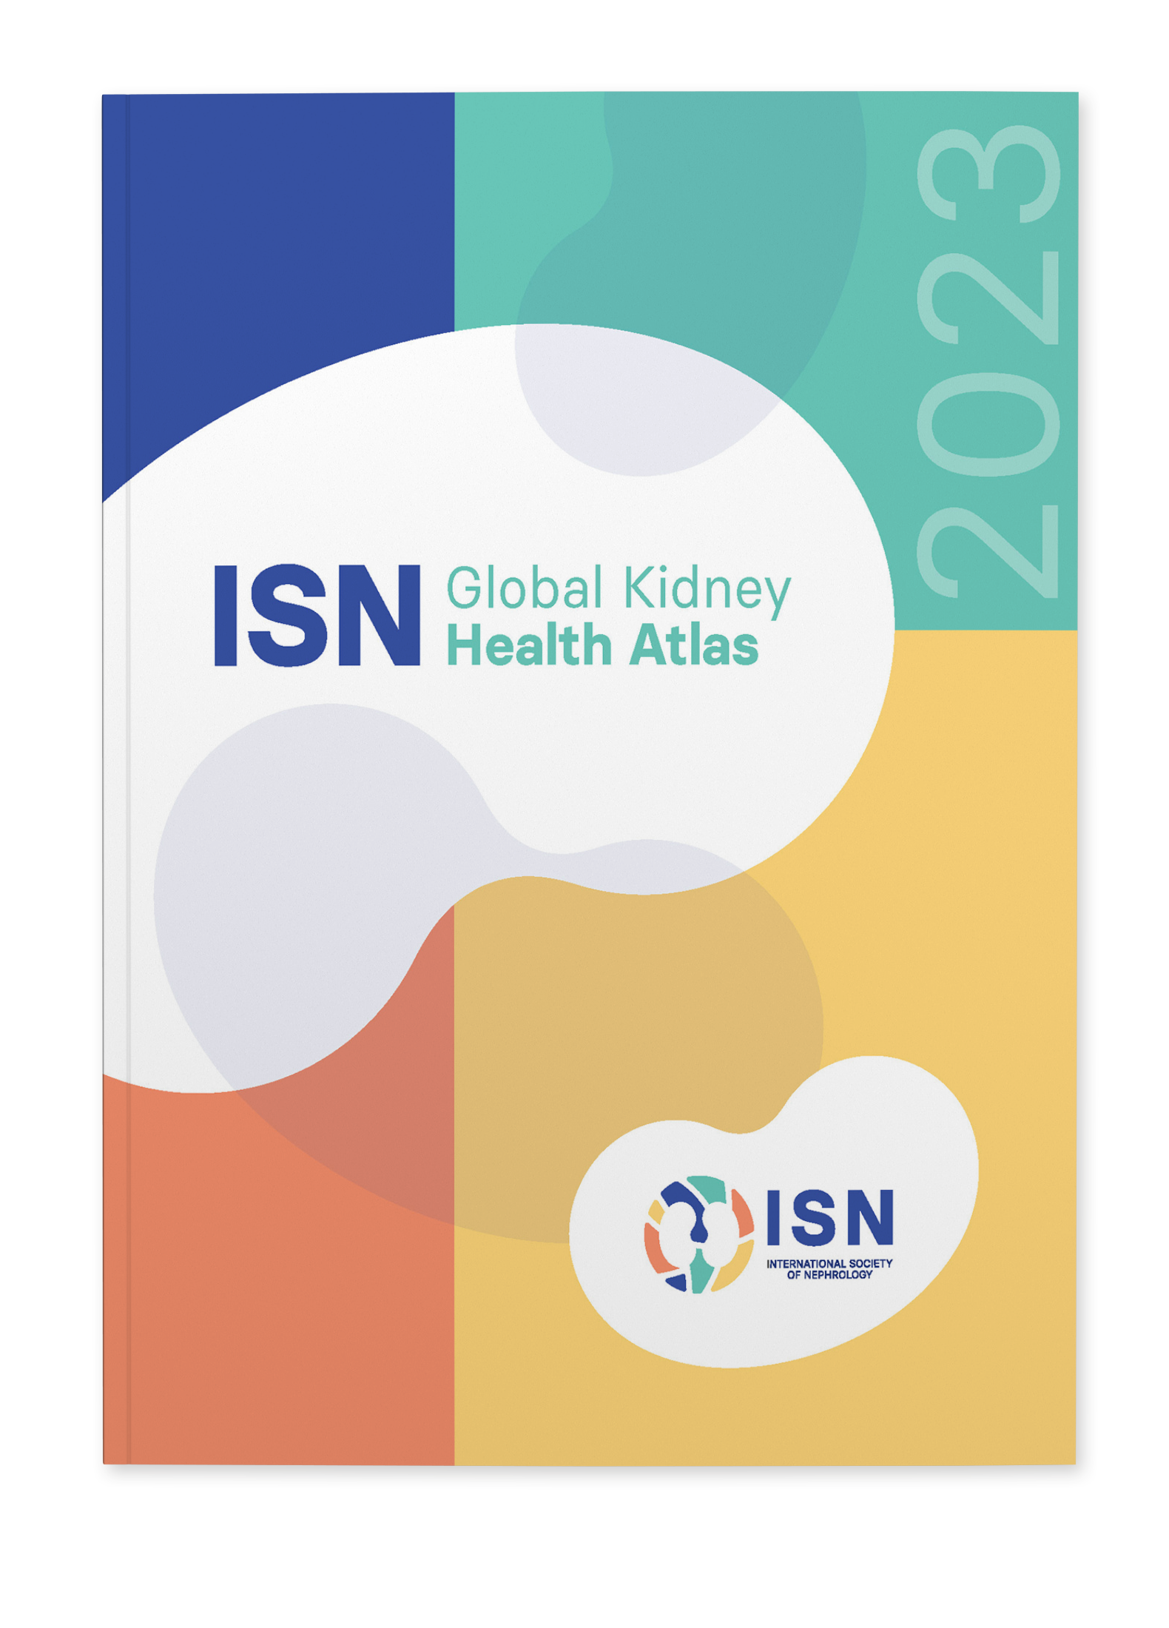
2023 ISN-GLOBAL KIDNEY HEALTH ATLAS (ISN-GKHA) ISN AFRICA REGION
www.theisn.org/global-atlas

Slide 3

Overview
Aim
Methods
Key Results

Slide 4
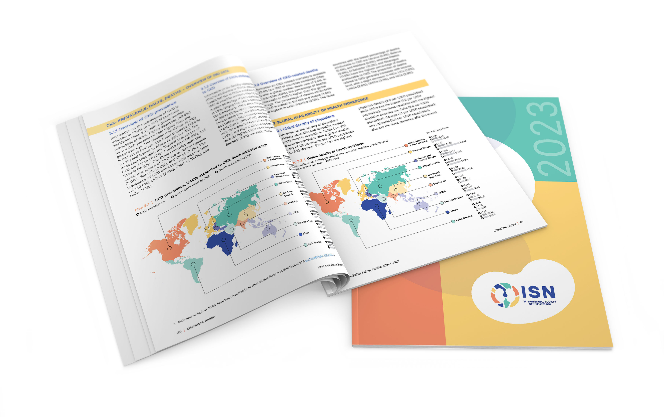
Aim of the ISN-Global Kidney Health Atlas
To understand, compare and monitor how different countries around the world detect, treat, monitor and advocate for people with kidney disease (AKI or CKD).
Key focus on availability, accessibility, affordability and quality of ESKD care

Slide 5
ISN-Global Kidney Health Atlas Survey
2016
2018
2022
2026

Slide 6
Design and Scope
Desk research (across countries and regions)
Published and grey literature review
Systematic review of kidney failure burden and outcomes
Data extraction from major kidney registries (USRDS, ERA-EDTA) and relevant national registries where available
Scoping review of KRT cost estimates
Online questionnaire-based survey July – September 2022
3 languages (English, French, Spanish)
191 countries contacted
≥3 stakeholders per country
National nephrology society leadership
Healthcare policymakers
Patients / patient advocacy groups
Discrepancies resolved by follow-up conferences with regional board chairs and country nephrology leaders
Notes:
REDCap Cloud. The questionnaire was peer reviewed for content validity and comprehensiveness before it was piloted with the 10 ISN regional boards to identify any logistical and feasibility issues (e.g., translation needs). Intensive follow-ups were conducted by email and telephone with ISN regional and national leaders to ensure complete and timely responses.
Data and reports published by the WHO Global Observatory, UN, World Bank, and OECD.
Both published and unpublished documents from international organizations/bodies and reports published by national governments on the organization and
delivery of ESKD.
Additional literature identified by key stakeholders (i.e., opinion leaders, national nephrology society leaders, ISN leaders) and through consultation with national nephrology societies and ISN regional boards.

Slide 7
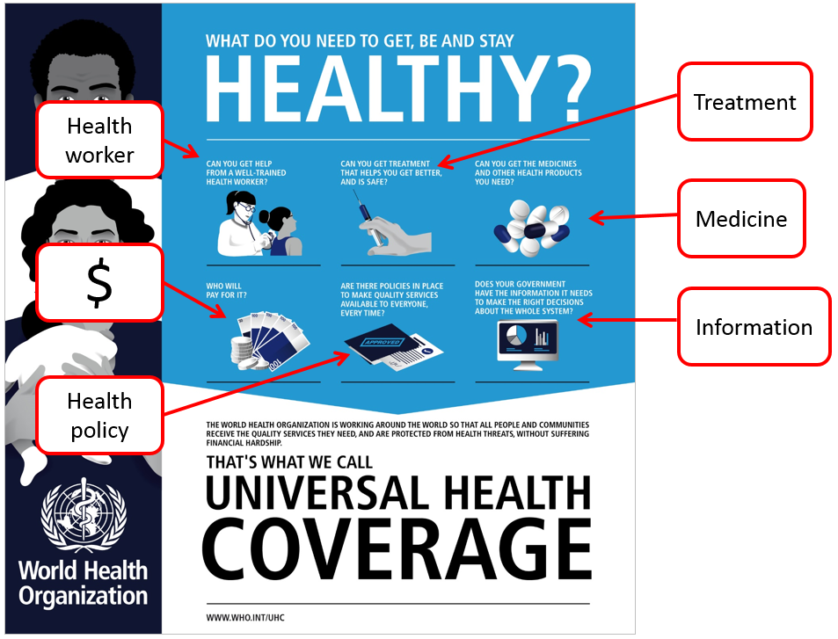
Overall Survey Components

Slide 8
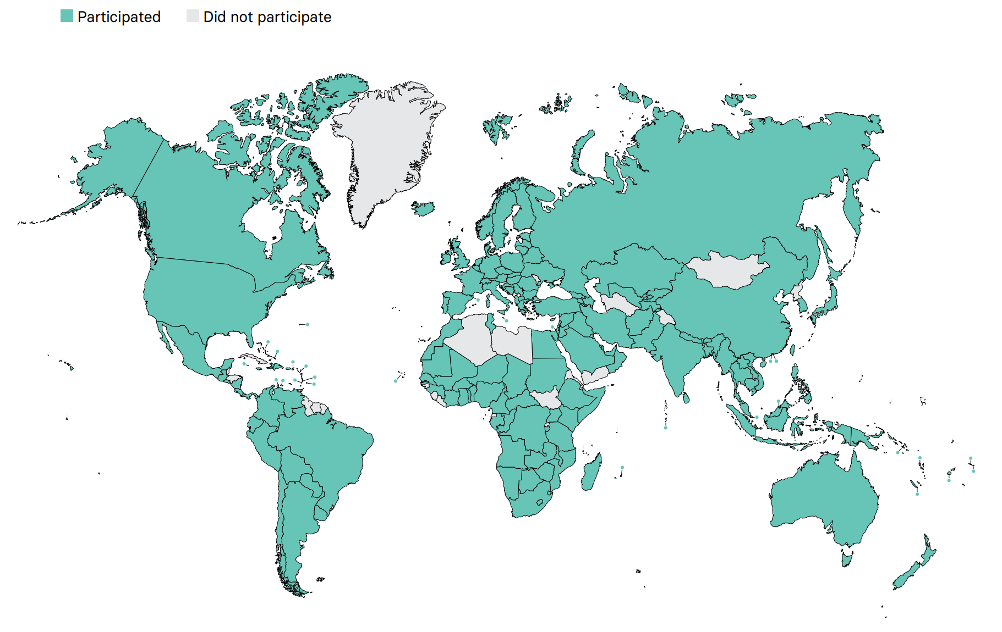
Overall ISN-GKHA response
167 countries (92%)
97% world’s population
329 individuals (63%) response
2 respondents/country (IQR 2-3)
108 countries participated in the 2017, 2019, and 2023 GKHA surveys

Slide 9
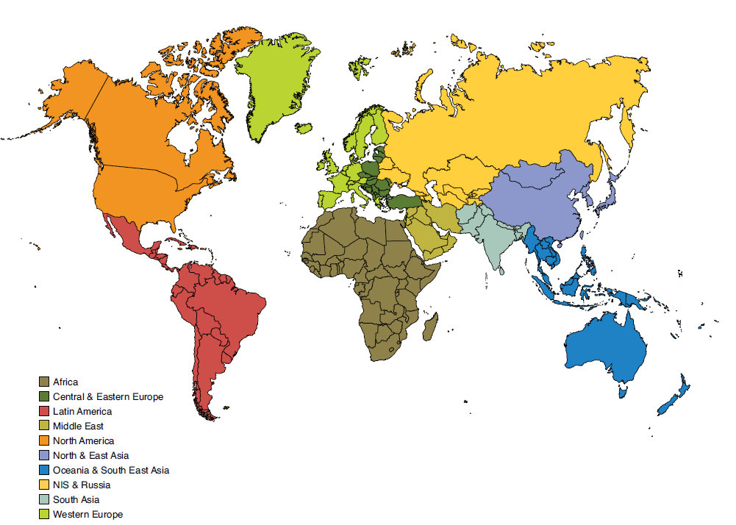
Results presented by ISN regions

Slide 10

ISN Region: Africa

Slide 11
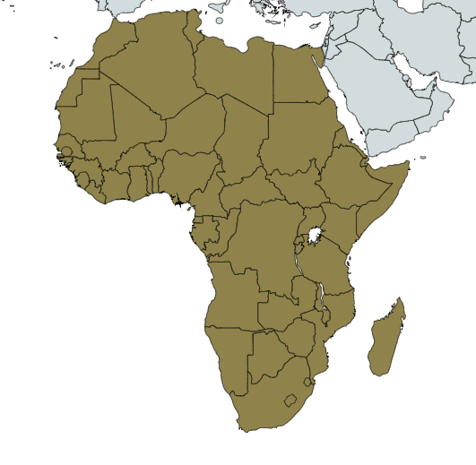
Demographics
Country | World bank ranking | Area (sq km) | Total population (2022) | GDP (PPP) ($ billion) | Total health expenditures (% of GDP)
Algeria | Lower-middle income | 2,381,741 | 44,178,884 | 535.8 | 6.2
Angola | Lower-middle income | 1,246,700 | 34,795,287 | 224.0 | 2.5
Benin | Lower-middle income | 112,622 | 13,754,688 | 47.4 | 2.4
Botswana | Upper-middle income | 581,730 | 2,384,246 | 42.2 | 6.1
Burkina Faso | Low income | 274,200 | 21,935,389 | 52.9 | 5.5
Burundi | Low income | 27,830 | 12,696,478 | 9.7 | 8
Cabo Verde | Lower-middle income | 4,033 | 596,707 | 3.9 | 4.9
Cameroon | Lower-middle income | 475,440 | 29,321,637 | 110.6 | 3.6
Chad | Low income | 1,284,000 | 17,963,211 | 26.9 | 4.4
Congo, Dem. Rep. | Low income | 2,344,858 | 108,400,000 | 113.1 | 3.5
Congo, Rep. | Lower-middle income | 342,000 | 5,546,307 | 20.7 | 2.1
Cote d'Ivoire | Lower-middle income | 322,463 | 28,713,423 | 160.7 | 3.3
Djibouti | Lower-middle income | 23,200 | 957,273 | 6.0 | 1.8
Egypt, Arab Rep. | Lower-middle income | 1,001,450 | 107,800,000 | 1388.3 | 4.7
Eritrea | Low income | 117,600 | 6,209,262 | - | 4.5
Ethiopia | Low income | 1,104,300 | 113,700,000 | 306.4 | 3.2
Gabon | Upper-middle income | 267,667 | 2,340,613 | 35.5 | 2.8
Gambia, The | Low income | 11,300 | 2,413,403 | 6.0 | 3.8
Ghana | Lower-middle income | 238,533 | 33,107,275 | 196.1 | 3.4
Guinea | Low income | 245,857 | 13,237,832 | 39.3 | 4
Kenya | Lower-middle income | 580,367 | 55,864,655 | 276.2 | 4.6
Liberia | Low income | 111,369 | 5,358,483 | 8.1 | 8.5
Libya | Upper middle income | 1,759,540 | 7,137,931 | 162.5 | -
Responses were received from 41 of 54 countries in Africa (75.9%) representing 93% of the region’s population.
‘ – ’ : data not reported/unavailable

Slide 12
Demographics (cont’d)
Country | World bank ranking | Area (sq km) | Total population (2022) | GDP (PPP) ($ billion) | Total health expenditures (% of GDP)
Madagascar | Low income | 587,041 | 28,172,462 | 46.5 | 3.7
Malawi | Low income | 118,484 | 20,794,353 | 32.6 | 7.4
Mali | Low income | 1,240,192 | 20,741,769 | 51.0 | 3.9
Mauritania | Lower-middle income | 1,030,700 | 4,161,925 | 26.9 | 3.3
Mauritius | Upper-middle income | 2,040 | 1,308,222 | - | 6.7
Morocco | Lower-middle income | 446,550 | 36,738,229 | 333.2 | 5.3
Mozambique | Low income | 799,380 | 31,693,239 | 43.2 | 7.8
Namibia | Upper-middle income | 824,292 | 2,727,409 | 25.4 | 8.5
Niger | Low income | 1,267,000 | 24,484,587 | 32.9 | 5.7
Nigeria | Lower-middle income | 923,768 | 225,100,000 | 1154.1 | 3
Rwanda | Low income | 26,338 | 13,173,730 | 33.1 | 6.4
Senegal | Lower-middle income | 196,722 | 17,923,036 | 64.8 | 4.1
Sierra Leone | Low income | 71, 740 | 8,692,606 | 14.9 | 8.8
Somalia | Low income | 637,657 | 12,386,248 | 21.3 | -
South Africa | Upper-middle income | 1,219,090 | 57,516,665 | 868.6 | 9.1
Sudan | Low income | 1,861,484 | 47,958,856 | 185.6 | 4.6
Swaziland | Lower-middle income | 17,364 | 1,121,761 | - | 6.8
Tanzania | Lower-middle income | 947,300 | 63,852,892 | 175.0 | 3.8
Togo | Low income | 56,785 | 8,492,333 | 20.2 | 5.7
Tunisia | Lower-middle income | 163,610 | 11,896,972 | 138.4 | 7
Uganda | Low income | 241,038 | 46,205,893 | 113.2 | 3.8
Zambia | Low income | 752,618 | 19,642,123 | 69.2 | 5.3
Zimbabwe | Lower-middle income | 390,757 | 15,121,004 | 37.2 | 7.7
Responses were received from 41 of 54 countries in Africa (75.9%) representing 93% of the region’s population.
‘ – ’ : data not reported/unavailable

Slide 13
Demographics
Country | World bank ranking | Area (sq km) | Total population (2022) | GDP (PPP) ($ billion) | Total health expenditures (% of GDP) | Total Health Spending per person | Government Health Spending per person | Out-of-pocket Health Spending per person
Algeria | Lower-middle income | 2,381,741 | 44,178,884 | 535.8 | 6.2 | 210 | 142 | 64
Angola | Lower-middle income | 1,246,700 | 34,795,287 | 224.0 | 2.5 | 55 | 24 | 18
Benin | Lower-middle income | 112,622 | 13,754,688 | 47.4 | 2.4 | 31 | 7 | 11
Botswana | Upper-middle income | 581,730 | 2,384,246 | 42.2 | 6.1 | 468 | 353 | 13
Burkina Faso | Low income | 274,200 | 21,935,389 | 52.9 | 5.5 | 44 | 17 | 12
Burundi | Low income | 27,830 | 12,696,478 | 9.7 | 8 | 33 | 6 | 5
Cabo Verde | Lower-middle income | 4,033 | 596,707 | 3.9 | 4.9 | 205 | 138 | 47
Cameroon | Lower-middle income | 475,440 | 29,321,637 | 110.6 | 3.6 | 47 | 3 | 31
Chad | Low income | 1,284,000 | 17,963,211 | 26.9 | 4.4 | 29 | 6 | 15
Congo, Dem. Rep. | Low income | 2,344,858 | 108,400,000 | 113.1 | 3.5 | 22 | 3 | 7
Congo, Rep. | Lower-middle income | 342,000 | 5,546,307 | 20.7 | 2.1 | 48 | 19 | 20
Cote d'Ivoire | Lower-middle income | 322,463 | 28,713,423 | 160.7 | 3.3 | 73 | 21 | 26
Djibouti | Lower-middle income | 23,200 | 957,273 | 6.0 | 1.8 | 52 | 28 | 16
Egypt, Arab Rep. | Lower-middle income | 1,001,450 | 107,800,000 | 1388.3 | 4.7 | 160 | 43 | 97
Eritrea | Low income | 117,600 | 6,209,262 | - | 4.5 | 17 | 3 | 5
Ethiopia | Low income | 1,104,300 | 113,700,000 | 306.4 | 3.2 | 27 | 6 | 9
Gabon | Upper-middle income | 267,667 | 2,340,613 | 35.5 | 2.8 | 253 | 158 | 53
Gambia, The | Low income | 11,300 | 2,413,403 | 6.0 | 3.8 | 48 | 9 | 6
Ghana | Lower-middle income | 238,533 | 33,107,275 | 196.1 | 3.4 | 78 | 35 | 26
Guinea | Low income | 245,857 | 13,237,832 | 39.3 | 4 | 51 | 7 | 25
Kenya | Lower-middle income | 580,367 | 55,864,655 | 276.2 | 4.6 | 101 | 41 | 22
Liberia | Low income | 111,369 | 5,358,483 | 8.1 | 8.5 | 73 | 9 | 22
Libya | Upper middle income | 1,759,540 | 7,137,931 | 162.5 | - | 741 | 580 | 151
‘ – ’ : data not reported/unavailable

Slide 14
Demographics (cont’d)
Country | World bank ranking | Area (sq km) | Total population (2022) | GDP (PPP) ($ billion) | Total health expenditures (% of GDP) | Total Health Spending per person | Government Health Spending per person | Out-of-pocket Health Spending per person
Madagascar | Low income | 587,041 | 28,172,462 | 46.5 | 3.7 | 23 | 10 | 6
Malawi | Low income | 118,484 | 20,794,353 | 32.6 | 7.4 | 50 | 12 | 4
Mali | Low income | 1,240,192 | 20,741,769 | 51.0 | 3.9 | 32 | 10 | 10
Mauritania | Lower-middle income | 1,030,700 | 4,161,925 | 26.9 | 3.3 | 66 | 23 | 29
Mauritius | Upper-middle income | 2,040 | 1,308,222 | - | 6.7 | - | - | -
Morocco | Lower-middle income | 446,550 | 36,738,229 | 333.2 | 5.3 | 176 | 81 | 79
Mozambique | Low income | 799,380 | 31,693,239 | 43.2 | 7.8 | 43 | 7 | 3
Namibia | Upper-middle income | 824,292 | 2,727,409 | 25.4 | 8.5 | 404 | 181 | 28
Niger | Low income | 1,267,000 | 24,484,587 | 32.9 | 5.7 | 31 | 9 | 13
Nigeria | Lower-middle income | 923,768 | 225,100,000 | 1154.1 | 3 | 76 | 11 | 58
Rwanda | Low income | 26,338 | 13,173,730 | 33.1 | 6.4 | 54 | 18 | 6
Senegal | Lower-middle income | 196,722 | 17,923,036 | 64.8 | 4.1 | 67 | 17 | 31
Sierra Leone | Low income | 71, 740 | 8,692,606 | 14.9 | 8.8 | 76 | 9 | 32
Somalia | Low income | 637,657 | 12,386,248 | 21.3 | - | 8 | 2 | 2
South Africa | Upper-middle income | 1,219,090 | 57,516,665 | 868.6 | 9.1 | 478 | 270 | 31
Sudan | Low income | 1,861,484 | 47,958,856 | 185.6 | 4.6 | 44 | 9 | 29
Swaziland | Lower-middle income | 17,364 | 1,121,761 | - | 6.8 | 237 | 97 | 23
Tanzania | Lower-middle income | 947,300 | 63,852,892 | 175.0 | 3.8 | 43 | 16 | 8
Togo | Low income | 56,785 | 8,492,333 | 20.2 | 5.7 | 42 | 9 | 21
Tunisia | Lower-middle income | 163,610 | 11,896,972 | 138.4 | 7 | 274 | 163 | 101
Uganda | Low income | 241,038 | 46,205,893 | 113.2 | 3.8 | 50 | 8 | 17
Zambia | Low income | 752,618 | 19,642,123 | 69.2 | 5.3 | 65 | 16 | 5
Zimbabwe | Lower-middle income | 390,757 | 15,121,004 | 37.2 | 7.7 | 78 | 13 | 13
‘ – ’ : data not reported/unavailable

Slide 15
CKD and its risk factors burden
Country | CKD Prevalence % (95% CI) | Death attributed to CKD % (95% CI) | DALYS attributed to CKD % (95% CI) | Obesity % (95% CI) | Increased BP % (95% CI) | Smoking % (95% CI)
Algeria | 9.54 (8.88 - 10.20) | 4.08 (3.36 - 5.16) | 2.32 (1.96 - 2.86) | 26.6 (21.7 - 32.0) | 25.1 (19.4 - 31.5) | 10.3 (8.4 - 12.5)
Angola | 3.38 (3.09 - 3.67) | 1.33 (1 - 1.54) | 0.78 (0.6 - 0.91) | 6.8 (4.2 - 10.3) | 29.7 (22.1 - 38.3) | 6.7 (5.6 - 8.0)
Benin | 3.76 (3.49 - 4.05) | 1.7 (1.38 - 2.04) | 0.94 (0.77 - 1.14) | 8.2 (6.0 - 10.8) | 27.7 (21.7 - 34.2) | 4.1 (3.3 - 5.0)
Botswana | 6.09 (5.60 - 6.57) | 2.09 (1.6 - 2.68) | 1.35 (1.03 - 1.7) | 16.1 (12.3 - 20.3) | 29.6 (23.4 - 36.4) | 11.1 (9.4 - 13.0)
Burkina Faso | 3.61 (3.35 - 3.89) | 1.4 (1.15 - 1.64) | 0.81 (0.65 - 0.97) | 4.5 (3.1 - 6.3) | 32.6 (25.3 - 40.1) | 7.5 (5.9 - 9.5)
Burundi | 3.20 (2.91 - 3.48) | 1.25 (1.06 - 1.46) | 0.7 (0.6 - 0.81) | 4.4 (2.8 - 6.6) | 29.2 (22.0 - 37.7) | 4.7 (3.7 - 5.8)
Cabo Verde | 6.36 (5.91 - 6.82) | 2.99 (2.67 - 3.28) | 1.81 (1.6 - 2.04) | 10.6 (7.5 - 14.0) | 29.5 (22.6 - 36.8) | 5.6 (4.3 - 7.1)
Cameroon | 4.70 (4.36 - 5.03) | 2.3 (1.86 - 2.81) | 1.36 (1.1 - 1.68) | 9.5 (7.1 - 12.2) | 24.8 (18.8 - 31.8) | 4.4 (3.6 - 5.3)
Chad | 3.16 (2.92 - 3.41) | 1.16 (0.92 - 1.49) | 0.63 (0.5 - 0.81) | 4.8 (3.3 - 6.8) | 32.9 (25.7 - 40.6) | 5.2 (4.1 - 6.5)
Congo, Dem. Rep. | 3.47 (3.19 - 3.76) | 1.42 (1.2 - 1.64) | 0.8 (0.67 - 0.95) | 5.6 (3.7 - 8.0) | 28.5 (21.1 - 36.5) | 6.3 (5.5 - 7.3)
Congo, Rep. | 4.37 (4.02 - 4.74) | 1.96 (1.43 - 2.39) | 1.16 (0.88 - 1.42) | 8.4 (5.8 - 11.5) | 26.2 (19.1 - 34.3) | 5.5 (4.6 - 6.7)
Cote d'Ivoire | 4.24 (3.94 - 4.58) | - | - | 9.0 (6.7 - 11.9) | 27.2 (20.7 - 34.2) | 7.3 (6.1 - 8.7)
Djibouti | 4.48 (4.10 - 4.88) | 1.79 (1.49 - 2.13) | 1.06 (0.88 - 1.26) | 12.2 (8.6 - 16.7) | 26.8 (19.5 - 35.0) | 11.4 (9.5 - 13.5)
Egypt, Arab Rep. | 7.99 (7.44 - 8.56) | 3.92 (2.5 - 5.3) | 2.49 (1.74 - 3.27) | 31.1 (26.7 - 35.5) | 25.0 (19.8 - 30.6) | 16.0 (14.4 - 17.8)
Eritrea | 3.56 (3.27 - 3.87) | 1.52 (1.11 - 1.9) | 0.97 (0.75 - 1.18) | 4.1 (2.6 - 6.0) | 29.1 (22.3 - 36.3) | 5.1 (4.0 - 6.4)
Ethiopia | 3.31 (3.05 - 3.61) | 1.76 (1.54 - 2.01) | 0.87 (0.75 - 0.99) | 3.6 (2.3 - 5.2) | 30.3 (23.1 - 38.0) | 3.1 (2.4 - 3.8)
Gabon | 5.09 (4.72 - 5.49) | 3.12 (2.09 - 3.86) | 1.77 (1.26 - 2.2) | 13.4 (9.5 - 18.1) | 25.5 (18.4 - 33.7) | 8.3 (7.0 - 9.8)
Gambia, The | 4.09 (3.78 - 4.41) | 2.29 (1.89 - 2.72) | 1.31 (1.03 - 1.6) | 8.7 (6.3 - 11.6) | 29.1 (22.5 - 36.4) | 8.9 (7.4 - 10.4)
Ghana | 4.63 (4.29 - 5.00) | 2.25 (1.66 - 2.7) | 1.35 (1.03 - 1.64) | 9.7 (7.5 - 12.2) | 23.7 (18.7 - 29.3) | 2.5 (2.0 - 3.1)
Guinea | 3.83 (3.56 - 4.10) | 1.69 (1.48 - 1.98) | 0.95 (0.82 - 1.13) | 6.6 (4.6 - 8.9) | 30.3 (23.7 - 37.4) | 3.8 (2.9 - 4.8)
Kenya | 3.78 (3.48 - 4.11) | 1.62 (1.42 - 1.88) | 0.92 (0.8 - 1.07) | 6.0 (4.3 - 8.2) | 26.7 (20.2 - 34.0) | 6.7 (6.5 - 7.0)
Liberia | 4.19 (3.87 - 4.52) | 2.17 (1.68 - 2.86) | 1.19 (0.9 - 1.58) | 8.6 (6.2 - 11.4) | 28.3 (22.2 - 35.2) | 4.5 (3.8 - 5.4)
Libya | 9.37 (8.73 - 9.99) | 4.34 (2.99 - 5.66) | 2.38 (1.83 - 2.99) | 31.8 (26.5 - 37.4) | 23.7 (18.0 - 29.8) | 13.0 (11.3 - 15.0)
Abbreviations: CKD (Chronic Kidney Disease), DALYS (disability-adjusted life years), BP (blood pressure), CI (confidence interval)
Data sources: GBD study database (http://www.healthdata.org/gbd), WHO data observatory (https://www.who.int/gho/en/)
‘ – ’ : data not reported/unavailable

Slide 16
CKD and its risk factors burden (cont’d)
Country | CKD Prevalence % (95% CI) | Death attributed to CKD % (95% CI) | DALYS attributed to CKD % (95% CI) | Obesity % (95% CI) | Increased BP % (95% CI) | Smoking % (95% CI)
Madagascar | 3.48 (3.18 - 3.80) | 1.18 (0.99 - 1.43) | 0.72 (0.61 - 0.85) | 4.5 (2.9 - 6.4) | 28.1 (21.4 - 35.4) | 9.2 (7.6 - 11.0)
Malawi | 5.31 (4.09 - 7.27) | 1.53 (1.34 - 1.72) | 0.87 (0.75 - 1) | 4.7 (3.2 - 6.5) | 28.9 (22.1 - 36.3) | 6.1 (5.1 - 7.3)
Mali | 3.49 (3.23 - 3.75) | 1.34 (1.12 - 1.59) | 0.72 (0.6 - 0.85) | 7.1 (5.1 - 9.6) | 32.6 (25.4 - 40.4) | 4.9 (4.1 - 6.0)
Mauritania | 4.72 (4.40 - 5.06) | 2.82 (2.18 - 3.44) | 1.47 (1.15 - 1.8) | 11.3 (8.3 - 14.9) | 31.7 (24.3 - 40.0) | 8.5 (6.7 - 10.8)
Mauritius | - | - | - | 11.5 (8.4 - 15.2) | 25.0 (18.9 - 31.9) | 15.8 (13.6 - 18.2)
Morocco | 9.64 (8.98 - 10.30) | 4.09 (3.42 - 5.02) | 2.58 (2.2 - 3.02) | 25.6 (20.7 - 30.9) | 26.1 (20.0 - 32.9) | 8.3 (6.8 - 10.0)
Mozambique | 3.27 (3.00 - 3.55) | 1 (0.85 - 1.15) | 0.62 (0.51 - 0.73) | 6.0 (4.1 - 8.2) | 29.1 (22.2 - 36.6) | 7.8 (6.5 - 9.3)
Namibia | 5.24 (4.86 - 5.63) | 1.85 (1.46 - 2.53) | 1.06 (0.85 - 1.39) | 15.0 (11.5 - 18.7) | 28.5 (22.3 - 35.0) | 10.4 (8.9 - 12.2)
Niger | 3.47 (3.18 - 3.78) | 1.09 (0.89 - 1.34) | 0.61 (0.5 - 0.74) | 4.7 (3.2 - 6.7) | 33.4 (25.9 - 41.4) | 4.0 (3.2 - 4.9)
Nigeria | 3.90 (3.61 - 4.19) | 1.26 (1.02 - 1.54) | 0.66 (0.53 - 0.82) | 7.8 (5.9 - 9.9) | 23.9 (18.7 - 29.5) | 2.9 (2.3 - 3.6)
Rwanda | 3.86 (3.53 - 4.18) | 1.85 (1.5 - 2.14) | 1.03 (0.85 - 1.21) | 4.8 (3.2 - 6.7) | 26.7 (19.7 - 34.3) | 6.3 (5.3 - 7.4)
Senegal | 4.21 (3.91 - 4.54) | 2.72 (2.19 - 3.41) | 1.46 (1.13 - 1.85) | 7.4 (5.2 - 9.9) | 30.2 (23.0 - 38.0) | 4.4 (3.7 - 5.3)
Sierra Leone | 4.06 (3.75 - 4.37) | 1.48 (1.21 - 1.77) | 0.86 (0.69 - 1.04) | 7.5 (5.3 - 10.1) | 30.3 (23.4 - 37.2) | 10.9 (9.3 - 12.8)
Somalia | 3.00 (2.75 - 3.28) | 1.02 (0.86 - 1.18) | 0.61 (0.52 - 0.7) | 6.9 (4.5 - 9.8) | 32.9 (25.2 - 41.3) | 6.0 (4.9 - 7.5)
South Africa | 7.28 (6.74 - 7.78) | 2.37 (2.16 - 2.53) | 1.38 (1.25 - 1.51) | 27.0 (23.4 - 30.8) | 26.9 (21.7 - 32.7) | 14.6 (13.9 - 15.3)
Sudan | 5.61 (5.20 - 6.01) | 2.35 (1.71 - 3.45) | 1.31 (1.01 - 1.72) | - | - | 1.0 (0.7 - 1.5)
Swaziland | 5.43 (5.02 - 5.87) | 2.32 (1.88 - 2.67) | 1.46 (1.16 - 1.74) | 13.5 (10.0 - 17.5) | 29.8 (23.3 - 37.0) | 4.7 (4.0 - 5.5)
Tanzania | 3.63 (3.33 - 3.93) | 1.76 (1.55 - 1.99) | 0.95 (0.82 - 1.09) | 7.1 (5.3 - 9.4) | 27.3 (21.4 - 33.8) | 6.9 (5.9 - 8.0)
Togo | 4.30 (3.97 - 4.63) | 1.87 (1.56 - 2.18) | 1.11 (0.9 - 1.31) | 7.1 (4.9 - 9.7) | 28.9 (22.4 - 35.8) | 3.9 (3.2 - 4.7)
Tunisia | 11.77 (10.99 - 12.52) | 3.9 (3.16 - 4.6) | 2.4 (2.02 - 2.8) | 27.3 (22.4 - 32.1) | 23.2 (17.7 - 29.0) | 19.9 (17.3 - 22.7)
Uganda | 2.98 (2.73 - 3.25) | 1.4 (1.13 - 1.69) | 0.73 (0.59 - 0.88) | 4.1 (2.8 - 5.8) | 27.3 (21.0 - 34.2) | 5.2 (4.4 - 6.2)
Zambia | 3.49 (3.21 - 3.80) | 1.56 (1.33 - 1.79) | 0.95 (0.79 - 1.1) | 6.5 (4.6 - 8.8) | 27.1 (20.8 - 34.1) | 6.5 (5.2 - 8.0)
Zimbabwe | 4.88 (4.47 - 5.30) | 1.81 (1.42 - 2.54) | 1.08 (0.85 - 1.47) | 12.3 (9.4 - 15.6) | 28.2 (21.6 - 35.7) | 8.8 (7.9 - 9.9)
Abbreviations: CKD (Chronic Kidney Disease), DALYS (disability-adjusted life years), BP (blood pressure), CI (confidence interval)
Data sources: GBD study database (http://www.healthdata.org/gbd), WHO data observatory (https://www.who.int/gho/en/)
‘ – ’ : data not reported/unavailablecal

Slide 17
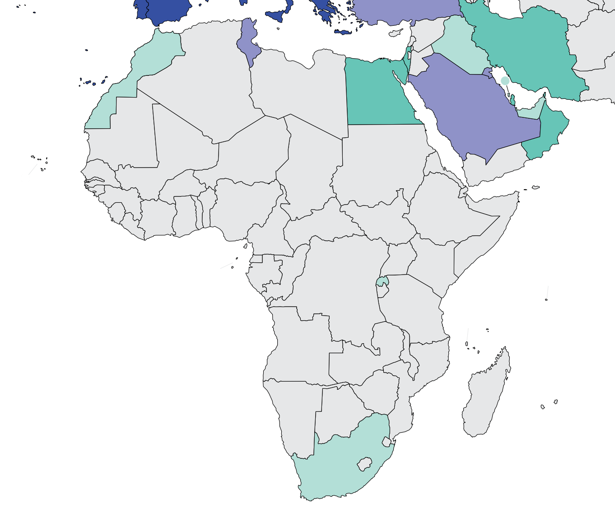
Burden of kidney failure
Country | Treated kidney failure |  | Chronic dialysis (HD+PD) |  | Chronic Hemodialysis |  | Chronic Peritoneal dialysis
 | Incidence | Prevalence | Incidence | Prevalence | Incidence | Prevalence | Incidence | Prevalence
Algeria | - | - | - | 251.4 | - | 240.3 | - | 11.1
Angola | - | - | - | 23.6 | - | 23.6 | - | 0
Benin | - | - | - | 30.2 | - | 30.2 | - | 0
Botswana | - | - | - | 18.3 | - | - | - | 18.3
Burkina Faso | - | - | - | - | - | - | - | -
Burundi | - | - | - | - | - | - | - | -
Cabo Verde | - | - | - | - | - | - | - | -
Cameroon | - | - | - | 23.6 | - | 12.2 | - | 0
Chad | - | - | - | - | - | - | - | -
Congo, Dem. Rep. | - | - | - | 0.6 | - | 0.34 | - | 0.34
Congo, Rep. | - | - | - | 8.5 | - | 0.4 | - | 0.3
Cote d'Ivoire | - | - | - | 23.3 | - | 23.3 | - | 0
Djibouti | - | - | - | - | - | - | - | -
Egypt, Arab Rep. | 56 | 624 | - | 610 | - | 517.7 | - | 0.1
Eritrea | - | - | - | - | - | - | - | -
Ethiopia | - | - | - | 5.8 | - | 5.8 | - | 0
Gabon | - | - | - | 103 | - | 103 | - | 0
Gambia, The | - | - | - | - | - | - | - | -
Ghana | - | - | - | 4.4 | - | 4.4 | - | 0
Guinea | - | - | - | - | - | - | - | -
Kenya | - | - | - | 10.3 | - | 9.2 | - | 1.1
Liberia | - | - | - | - | - | - | - | -
Libya | - | - | - | 360.1 | - | 347.1 | - | 8.3
Prevalence of treated kidney failure
Treated kidney failure: all dialysis + transplant
* pmp (per million population)
Data sources: Abu-Aisha & Elamin (Peritoneal Dialysis International) 2010, Jain et al. (JASN) 2012, Liyanage et al. (The Lancet) 2015, 2017/2018 USRDS Annual Data Report
‘ – ’ : data not reported/unavailable

Slide 18
Burden of kidney failure (cont’d)
Country | Treated kidney failure |  | Chronic dialysis (HD+PD) |  | Chronic Hemodialysis |  | Chronic Peritoneal dialysis
 | Incidence | Prevalence | Incidence | Prevalence | Incidence | Prevalence | Incidence | Prevalence
Madagascar | - | - | - | 5.1 | - | 5.1 | - | 0
Malawi | - | - | - | - | - | - | - | -
Mali | - | - | - | 3.9 | - | 3.9 | - | 0
Mauritania | - | - | - | 80.5 | - | 80.5 | - | 0
Mauritius | - | - | - | 648.8 | - | 648.8 | - | 0
Morocco | 144 | 541 |  | 185.6 | - | 185 | - | 0.6
Mozambique | - | - | - | 0.92 | - | 0.92 | - | 0.92
Namibia | - | - | - | 16.8 | - | 16.8 | - | 9.6
Niger | - | - | - | - | - | - | - | -
Nigeria | - | - | - | 7.4 | - | 7.4 | - | 0
Rwanda | - | 4.4 | - | 2.8 | - | - | - | -
Senegal | - | - | - | 11.3 | - | 9.7 | - | 1.6
Sierra Leone | - | - | - | - | - | - | - | -
Somalia | - | - | - | - | - | - | - | -
South Africa | 22 | 169 | - | 156 | - | 134.3 | - | 23.3
Sudan | - | - | - | 70.4 | - | 67.9 | - | 2.5
Swaziland | - | - | - | 15.4 | - | 15.4 | - | 0
Tanzania | - | - | - | 0.5 | - | 0.5 | - | 0
Togo | - | - | - | 8.3 | - | 8.3 | - | 0
Tunisia | 242 | 1018 | - | 759.6 | - | 722.8 | - | 36.8
Uganda | - | - | - | 1.2 | - | 1.2 | - | 0.66
Zambia | - | - | - | 2.9 | - | 1.7 | - | 1.7
Zimbabwe | - | - | - | 2.8 | - | 2.8 | - | 2.8
Prevalence of treated kidney failure
Treated kidney failure: all dialysis + transplant
* pmp (per million population)
Data sources: Abu-Aisha & Elamin (Peritoneal Dialysis International) 2010, ERA-EDTA Registry Annual Report 2016/2017, Jain et al. (JASN) 2012, South African Renal Registry Annual Report 2019, 2017/2018 USRDS Annual Data Report
‘ – ’ : data not reported/unavailable

Slide 19
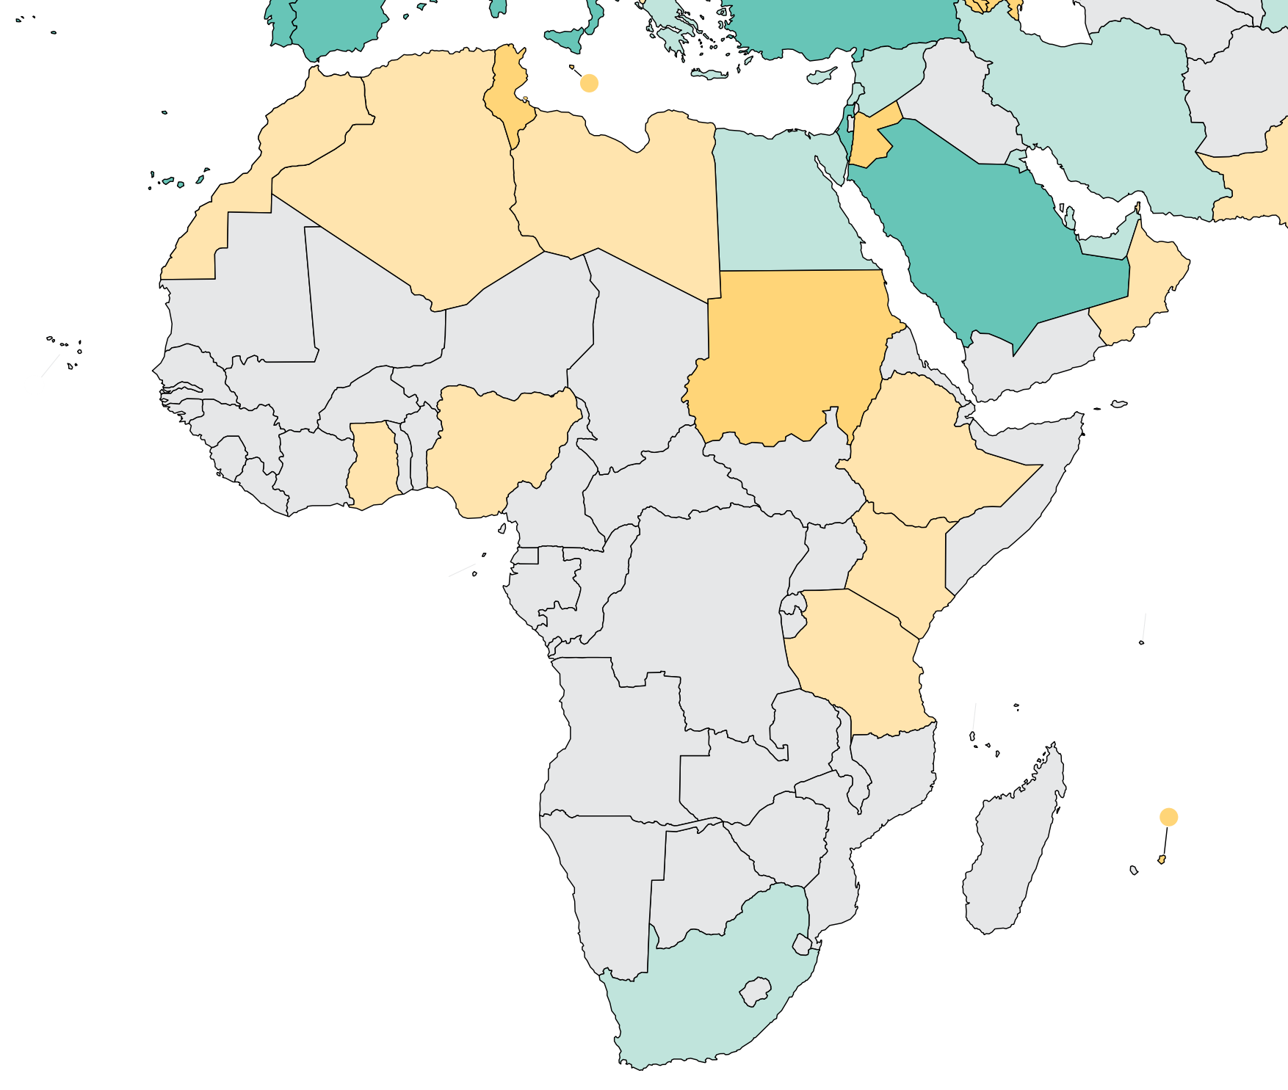
Burden of kidney failure (cont’d)
Country | Kidney transplantation
 | Incidence overall | Prevalence overall | Incidence of deceased donor | Incidence of living donor | Incidence of pre-emptive
Algeria | 2.07 | - | 0 | 2.07 | -
Angola | - | - | - | - | -
Benin | - | - | - | - | -
Botswana | - | - | - | - | -
Burkina Faso | - | - | - | - | -
Burundi | - | - | - | - | -
Cabo Verde | - | - | - | - | -
Cameroon | - | - | - | - | -
Chad | - | - | - | - | -
Congo, Dem. Rep. | - | - | - | - | -
Congo, Rep. | - | - | - | - | -
Cote d'Ivoire | - | - | - | - | -
Djibouti | - | - | - | - | -
Egypt, Arab Rep. | 15.49 | - | 0 | 15.49 | -
Eritrea | - | - | - | - | -
Ethiopia | 0.07 | - | 0 | 0.07 | -
Gabon | - | - | - | - | -
Gambia, The | - | - | - | - | -
Ghana | 0.11 | - | 0 | 0.11 | -
Guinea | - | - | - | - | -
Kenya | 2.91 | - | 0 | 2.91 | -
Liberia | - | - | - | - | -
Libya | 0.79 | - | 0 | 0.79 | -
Incidence of kidney transplantation
* pmp (per million population)
Data sources: GODT database (http://www.transplant-observatory.org/data-charts-and-tables/)
‘ – ’ : data not reported/unavailable

Slide 20
Burden of kidney failure (cont’d)
Country | Kidney transplantation
 | Incidence overall | Prevalence overall | Incidence of deceased donor | Incidence of living donor | Incidence of pre-emptive
Madagascar | - | - | - | - | -
Malawi | - | - | - | - | -
Mali | - | - | - | - | -
Mauritania | - | - | - | - | -
Mauritius | 10.77 | - | 0 | 10.77
Morocco | 0.35 | - | 0.14 | 0.22
Mozambique | - | - | - | - | -
Namibia | - | - | - | - | -
Niger | - | - | - | - | -
Nigeria | 0.8 |  | 0 | 0.8
Rwanda | - | - | - | - | -
Senegal | - | - | - | - | -
Sierra Leone | - | - | - | - | -
Somalia | - | - | - | - | -
South Africa | 15 | 25.4 | 2.16 | 1.85 | -
Sudan | 3.17 | - | 0 | 3.17 | -
Swaziland | - | - | - | - | -
Tanzania | 0.13 | - | 0 | 0.13 | -
Togo | - | - | - | - | -
Tunisia | 11.06 | - | 1.59 | 0.88 | -
Uganda | - | - | - | - | -
Zambia | - | - | - | - | -
Zimbabwe | - | - | - | - | -
Incidence of kidney transplantation
* pmp (per million population)
Data sources: GODT database (http://www.transplant-observatory.org/data-charts-and-tables/), South African Renal Registry Annual Report 2016
‘ – ’ : data not reported/unavailable

Slide 21
Annual cost of kidney replacement therapy components
Country | Hemodialysis | Peritoneal dialysis | Kidney Transplant (First year) | Kidney Transplant (later years) | HD/PD cost ratio
Algeria | 10115 | - | - | - | -
Angola | - | - | - | - | -
Benin | - | - | - | - | -
Botswana | - | - | - | - | -
Burkina Faso | 1646 | - | - | - | -
Burundi | 13793 | - | - | - | -
Cabo Verde | - | - | - | - | -
Cameroon | 1724 | - | - | - | -
Chad | - | - | - | - | -
Congo, Dem. Rep. | 32538 | 45571 | - | - | 0.71
Congo, Rep. | - | - | - | - | -
Cote d'Ivoire | - | - | - | - | -
Djibouti | - | - | - | - | -
Egypt, Arab Rep. | 2707 | 2772 | 8318 | 5699 | 0.98
Eritrea | - | - | - | - | -
Ethiopia | 4737 | - | - | - | -
Gabon | - | - | - | - | -
Gambia, The | - | - | - | - | -
Ghana | - | - | 18614 | - | -
Guinea | - | - | - | - | -
Kenya | 20254 | 15190 | - | - | 1.33
Liberia | - | - | - | - | -
Libya | - | - | - | - | -
*Cost is in $US 2021
Abbreviations: HD (hemodialysis), PD (peritoneal dialysis)
Data sources: Abu Aisha & Elamin (2010), Bahadi et al. (2022), Boima et al. (2020), Elsharif et al. (2010), Haddiya et al. (2012), Izeidi et al. (2020), Kassa et al. (2020), Lang et al. (2022), Mushi et al. (2015), Obadiah et al. (2022), Okafor & Kankam (2012), Soliman et al. (2012), Sumaili et al. (2009), Toure et al. (2022), van der Tol et al. (2019), Yousif et al. (2021)
‘ – ’ : data not reported/unavailable

Slide 22
Annual cost of kidney replacement therapy components (cont’d)
Country | Hemodialysis | Peritoneal dialysis | Kidney Transplant (First year) | Kidney Transplant (later years) | HD/PD ratio
Madagascar | - | - | - | - | -
Malawi | - | - | - | - | -
Mali | - | - | - | - | -
Mauritania | - | - | - | - | -
Mauritius | - | - | - | - | -
Morocco | 13901 | 7503 | 91760 | 18705 | 1.85
Mozambique | - | - | - | - | -
Namibia | 31014 | 31014 | - | - | 1.00
Niger | - | - | - | - | -
Nigeria | 23576 | 29830 | 38046 | - | 0.79
Rwanda | - | - | - | - | -
Senegal | 11818 | 13826 | - | - | 0.85
Sierra Leone | - | - | - | - | -
Somalia | - | - | - | - | -
South Africa | 15154 | 8068 | 27619 | 20714 | 1.88
Sudan | 4185 | 14557 | 18269 | 13126 | 0.29
Swaziland | - | - | - | - | -
Tanzania | 31571 | - | - | - | -
Togo | - | - | - | - | -
Tunisia | 6609 | 6101 | 20714 | 9666 | 1.08
Uganda | - | - | - | - | -
Zambia | - | - | - | - | -
Zimbabwe | 32331 | - | - | - | -
*Cost is in $US 2021
Abbreviations: HD (hemodialysis), PD (peritoneal dialysis)
Data sources: Abu Aisha & Elamin (2010), Bahadi et al. (2022), Boima et al. (2020), Elsharif et al. (2010), Haddiya et al. (2012), Izeidi et al. (2020), Kassa et al. (2020), Lang et al. (2022), Mushi et al. (2015), Obadiah et al. (2022), Okafor & Kankam (2012), Soliman et al. (2012), Sumaili et al. (2009), Toure et al. (2022), van der Tol et al. (2019), Yousif et al. (2021)
‘ – ’ : data not reported/unavailable

Slide 23
Country level scorecard
Country |  | Availability of KRT |  |  | Availability of CKM |  |  | Funding for Medications |  |  | Availability of Distribution of Registry |  |  |  | Advocacy Group |  |  | Nephrology Workforce (PMP)
 |  | HD | PD | Kidney transplantation | Shared decision | Choice restricted (limited) | Choice restricted (not limited) | CKD | Dialysis | Kidney transplantation | CKD | Dialysis | Kidney transplantation | AKI | CKD | AKI | RRT | Nephrologist | Nephrologist trainees
Algeria | 2019 |  |  |  |  |  |  |  |  |  |  |  |  |  |  |  |  | 12.00 | 1.92
 | 2023
Angola | 2019 |  |  |  |  |  |  |  |  |  |  |  |  |  |  |  |  | 0.99 | 0.40
 | 2023 |  |  |  |  |  |  |  |  |  |  |  |  |  |  |  |  | 1.52 | 0.49
Benin | 2019 |  |  |  |  |  |  |  |  |  |  |  |  |  |  |  |  | 0.88 | 0.53
 | 2023 |  |  |  |  |  |  |  |  |  |  |  |  |  |  |  |  | 1.09 | 0.00
Botswana | 2019 |  |  |  |  |  |  |  |  |  |  |  |  |  |  |  |  | 0.67 | 0.89
 | 2023 |  |  |  |  |  |  |  |  |  |  |  |  |  |  |  |  | 2.10 | 1.26
Burkina Faso | 2019 |  |  |  |  |  |  |  |  |  |  |  |  |  |  |  |  | 0.66 | 0.86
 | 2023 |  |  |  |  |  |  |  |  |  |  |  |  |  |  |  |  | 1.41 | 1.23
Burundi | 2019 |  |  |  |  |  |  |  |  |  |  |  |  |  |  |  |  | 0.17
 | 2023 |  |  |  |  |  |  |  |  |  |  |  |  |  |  |  |  | 0.24 | 0.24
Cameroon | 2019 |  |  |  |  |  |  |  |  |  |  |  |  |  |  |  |  | 0.60 | 0.31
 | 2023 |  |  |  |  |  |  |  |  |  |  |  |  |  |  |  |  | 0.51 | 0.17
Cape Verde | 2019 |  |  |  |  |  |  |  |  |  |  |  |  |  |  |  |  | 3.52 | 3.52
 | 2023 |  |  |  |  |  |  |  |  |  |  |  |  |  |  |  |  | 3.35 | 0.00
Central African Republic | 2019
 | 2023 |  |  |  |  |  |  |  |  |  |  |  |  |  |  |  |  | 0.18 | 0.00
Chad | 2019 |  |  |  |  |  |  |  |  |  |  |  |  |  |  |  |  | 0.19
 | 2023 |  |  |  |  |  |  |  |  |  |  |  |  |  |  |  |  | 0.17 | 0.00
Congo, Dem. Rep. | 2019 |  |  |  |  |  |  |  |  |  |  |  |  |  |  |  |  | 0.27 | 0.00
 | 2023 |  |  |  |  |  |  |  |  |  |  |  |  |  |  |  |  | 0.30 | 0.06
Abbreviations
AKI: acute kidney injury
CKD: chronic kidney disease
CKM: conservative kidney management
HD: Hemodialysis
KRT: kidney replacement therapy
PD: Peritoneal Dialysis
RRT: renal replacement therapy
Yes | No | N/A

Slide 24
Country level scorecard (cont’d)
Country |  | Availability of KRT |  |  | Availability of CKM |  |  | Funding for Medications |  |  | Availability of Distribution of Registry |  |  |  | Advocacy Group |  |  | Nephrology Workforce (PMP)
 |  | HD | PD | Kidney transplantation | Shared decision | Choice restricted (limited) | Choice restricted (not limited) | CKD | Dialysis | Kidney transplantation | CKD | Dialysis | Kidney transplantation | AKI | CKD | AKI | RRT | Nephrologist | Nephrologist trainees
Congo, Rep. | 2019 |  |  |  |  |  |  |  |  |  |  |  |  |  |  |  |  | 1.58 | 0.00
 | 2023 |  |  |  |  |  |  |  |  |  |  |  |  |  |  |  |  | 1.80 | 0.72
Cote d’Ivoire | 2019 |  |  |  |  |  |  |  |  |  |  |  |  |  |  |  |  | 1.03 | 0.19
 | 2023 |  |  |  |  |  |  |  |  |  |  |  |  |  |  |  |  | 1.22 | 0.28
Egypt | 2019 |  |  |  |  |  |  |  |  |  |  |  |  |  |  |  |  | 23.14 | 3.02
 | 2023 |  |  |  |  |  |  |  |  |  |  |  |  |  |  |  |  | 32.88 | 3.71
Eritrea | 2019
 | 2023
Ethiopia | 2019 |  |  |  |  |  |  |  |  |  |  |  |  |  |  |  |  | 0.14 | 0.06
 | 2023 |  |  |  |  |  |  |  |  |  |  |  |  |  |  |  |  | 0.25 | 0.08
Gabon | 2019 |  |  |  |  |  |  |  |  |  |  |  |  |  |  |  |  | 4.72
 | 2023 |  |  |  |  |  |  |  |  |  |  |  |  |  |  |  |  | 6.84 | 6.41
Gambia | 2019 |  |  |  |  |  |  |  |  |  |  |  |  |  |  |  |  | 0.48 | 0.48
 | 2023 |  |  |  |  |  |  |  |  |  |  |  |  |  |  |  |  | 2.07 | 0.00
Ghana | 2019 |  |  |  |  |  |  |  |  |  |  |  |  |  |  |  |  | 0.28 | 0.14
 | 2023 |  |  |  |  |  |  |  |  |  |  |  |  |  |  |  |  | 0.36 | 0.12
Guinea | 2019 |  |  |  |  |  |  |  |  |  |  |  |  |  |  |  |  | 0.51 | 0.67
 | 2023 |  |  |  |  |  |  |  |  |  |  |  |  |  |  |  |  | 1.13 | 0.60
Kenya | 2019 |  |  |  |  |  |  |  |  |  |  |  |  |  |  |  |  | 0.62 | 0.08
 | 2023 |  |  |  |  |  |  |  |  |  |  |  |  |  |  |  |  | 0.91 | 0.09
Lesotho | 2019
 | 2023 |  |  |  |  |  |  |  |  |  |  |  |  |  |  |  |  | 93.44 | 6.84
Abbreviations
AKI: acute kidney injury
CKD: chronic kidney disease
CKM: conservative kidney management
HD: Hemodialysis
KRT: kidney replacement therapy
PD: Peritoneal Dialysis
RRT: renal replacement therapy
Yes | No | N/A

Slide 25
Country level scorecard (cont’d)
Country |  | Availability of KRT |  |  | Availability of CKM |  |  | Funding for Medications |  |  | Availability of Distribution of Registry |  |  |  | Advocacy Group |  |  | Nephrology Workforce (PMP)
 |  | HD | PD | Kidney transplantation | Shared decision | Choice restricted (limited) | Choice restricted (not limited) | CKD | Dialysis | Kidney transplantation | CKD | Dialysis | Kidney transplantation | AKI | CKD | AKI | RRT | Nephrologist | Nephrologist trainees
Liberia | 2019 |  |  |  |  |  |  |  |  |  |  |  |  |  |  |  |  | 0.21 | 0.00
 | 2023
Libya | 2019
 | 2023
Madagascar | 2019 |  |  |  |  |  |  |  |  |  |  |  |  |  |  |  |  | 0.19 | 0.23
 | 2023 |  |  |  |  |  |  |  |  |  |  |  |  |  |  |  |  | 0.14 | 0.18
Malawi | 2019 |  |  |  |  |  |  |  |  |  |  |  |  |  |  |  |  | 0.00 | 0.00
 | 2023 |  |  |  |  |  |  |  |  |  |  |  |  |  |  |  |  | 0.05 | 0.00
Mali | 2019
 | 2023 |  |  |  |  |  |  |  |  |  |  |  |  |  |  |  |  | 1.78 | 0.19
Mauritania | 2019 |  |  |  |  |  |  |  |  |  |  |  |  |  |  |  |  | 1.56 | 1.56
 | 2023 |  |  |  |  |  |  |  |  |  |  |  |  |  |  |  |  | 2.64 | 0.72
Mauritius | 2019
 | 2023 |  |  |  |  |  |  |  |  |  |  |  |  |  |  |  |  | 7.64 | 2.29
Morocco | 2019 |  |  |  |  |  |  |  |  |  |  |  |  |  |  |  |  | 12.53 | 2.19
 | 2023 |  |  |  |  |  |  |  |  |  |  |  |  |  |  |  |  | 15.24 | 2.72
Mozambique | 2019 |  |  |  |  |  |  |  |  |  |  |  |  |  |  |  |  | 0.11 | 0.11
 | 2023 |  |  |  |  |  |  |  |  |  |  |  |  |  |  |  |  | 0.09 | 0.03
Namibia | 2019 |  |  |  |  |  |  |  |  |  |  |  |  |  |  |  |  | 0.79 | 0.99
 | 2023 |  |  |  |  |  |  |  |  |  |  |  |  |  |  |  |  | 1.10 | 0.00
Niger | 2019 |  |  |  |  |  |  |  |  |  |  |  |  |  |  |  |  | 0.35 | 0.00
 | 2023 |  |  |  |  |  |  |  |  |  |  |  |  |  |  |  |  | 0.33 | 0.00
Abbreviations
AKI: acute kidney injury
CKD: chronic kidney disease
CKM: conservative kidney management
HD: Hemodialysis
KRT: kidney replacement therapy
PD: Peritoneal Dialysis
RRT: renal replacement therapy
Yes | No | N/A

Slide 26
Country level scorecard (cont’d)
Country |  | Availability of KRT |  |  | Availability of CKM |  |  | Funding for Medications |  |  | Availability of Distribution of Registry |  |  |  | Advocacy Group |  |  | Nephrology Workforce (PMP)
 |  | HD | PD | Kidney transplantation | Shared decision | Choice restricted (limited) | Choice restricted (not limited) | CKD | Dialysis | Kidney transplantation | CKD | Dialysis | Kidney transplantation | AKI | CKD | AKI | RRT | Nephrologist | Nephrologist trainees
Nigeria | 2019 |  |  |  |  |  |  |  |  |  |  |  |  |  |  |  |  | 0.84 | 0.49
 | 2023 |  |  |  |  |  |  |  |  |  |  |  |  |  |  |  |  | 1.55 | 0.22
Rwanda | 2019
 | 2023
Senegal | 2019 |  |  |  |  |  |  |  |  |  |  |  |  |  |  |  |  | 2.00 | 4.33
 | 2023 |  |  |  |  |  |  |  |  |  |  |  |  |  |  |  |  | 2.34 | 3.07
Sierra Leone | 2019 |  |  |  |  |  |  |  |  |  |  |  |  |  |  |  |  | 0.16 | 0.00
 | 2023
Somalia | 2019 |  |  |  |  |  |  |  |  |  |  |  |  |  |  |  |  | 0.27 | 0.89
 | 2023
South Africa | 2019 |  |  |  |  |  |  |  |  |  |  |  |  |  |  |  |  | 2.71 | 0.36
 | 2023 |  |  |  |  |  |  |  |  |  |  |  |  |  |  |  |  | 2.61 | 0.17
Sudan | 2019 |  |  |  |  |  |  |  |  |  |  |  |  |  |  |  |  | 1.32 | 0.36
 | 2023 |  |  |  |  |  |  |  |  |  |  |  |  |  |  |  |  | 0.98 | 0.23
Swaziland | 2019 |  |  |  |  |  |  |  |  |  |  |  |  |  |  |  |  | 0.92 | 0.92
 | 2023 |  |  |  |  |  |  |  |  |  |  |  |  |  |  |  |  | 1.78 | 0.00
Tanzania | 2019 |  |  |  |  |  |  |  |  |  |  |  |  |  |  |  |  | 0.20 | 0.11
 | 2023 |  |  |  |  |  |  |  |  |  |  |  |  |  |  |  |  | 0.49 | 0.13
Togo | 2019
 | 2023 |  |  |  |  |  |  |  |  |  |  |  |  |  |  |  |  | 0.35 | 1.18
Tunisia | 2019 |  |  |  |  |  |  |  |  |  |  |  |  |  |  |  |  | 15.63 | 5.51
 | 2023 |  |  |  |  |  |  |  |  |  |  |  |  |  |  |  |  | 18.49 | 5.46
Abbreviations
AKI: acute kidney injury
CKD: chronic kidney disease
CKM: conservative kidney management
HD: Hemodialysis
KRT: kidney replacement therapy
PD: Peritoneal Dialysis
RRT: renal replacement therapy
Yes | No | N/A

Slide 27
Country level scorecard (cont’d)
Country |  | Availability of KRT |  |  | Availability of CKM |  |  | Funding for Medications |  |  | Availability of Distribution of Registry |  |  |  | Advocacy Group |  |  | Nephrology Workforce (PMP)
 |  | HD | PD | Kidney transplantation | Shared decision | Choice restricted (limited) | Choice restricted (not limited) | CKD | Dialysis | Kidney transplantation | CKD | Dialysis | Kidney transplantation | AKI | CKD | AKI | RRT | Nephrologist | Nephrologist trainees
Uganda | 2019 |  |  |  |  |  |  |  |  |  |  |  |  |  |  |  |  | 0.24
 | 2023 |  |  |  |  |  |  |  |  |  |  |  |  |  |  |  |  | 0.30 | 0.00
Zambia | 2019 |  |  |  |  |  |  |  |  |  |  |  |  |  |  |  |  | 0.30 | 0.06
 | 2023 |  |  |  |  |  |  |  |  |  |  |  |  |  |  |  |  | 0.31 | 0.00
Zimbabwe | 2019 |  |  |  |  |  |  |  |  |  |  |  |  |  |  |  |  | 0.36 | 0.00
 | 2023 |  |  |  |  |  |  |  |  |  |  |  |  |  |  |  |  | 0.40 | 0.07
Abbreviations
AKI: acute kidney injury
CKD: chronic kidney disease
CKM: conservative kidney management
HD: Hemodialysis
KRT: kidney replacement therapy
PD: Peritoneal Dialysis
RRT: renal replacement therapy
Yes | No | N/A

Slide 28
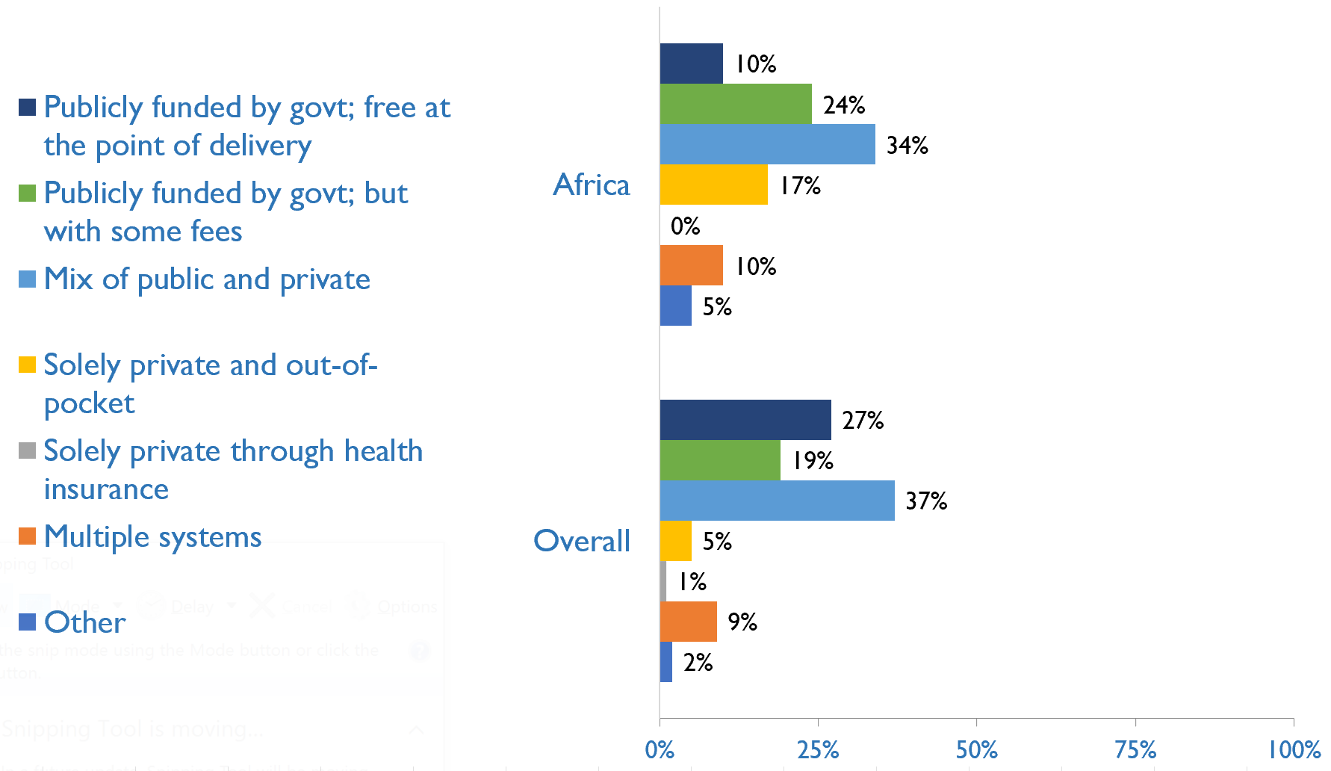
Funding for non-dialysis CKD
Country | Publicly funded by govt; free at the point of delivery | Publicly funded by govt but with some fees | Mix of public and private funding systems | Solely private and out-of-pocket | Solely private through health insurance | Multiple systems | Other
Angola |  | X
Benin |  |  | X
Botswana | X
Burkina Faso |  |  | X
Burundi |  |  |  |  |  | X
Cameroon |  |  |  |  | X
Cape Verde |  | X
C African Republic | X
Chad |  | X
Congo, Dem. Rep. |  |  |  | X
Congo, Rep. |  |  |  |  |  | X
Cote d'Ivoire |  | X
Egypt, Arab Rep. |  |  | X
Ethiopia |  |  | X
Gabon |  |  |  |  |  |  | X
Gambia, The | X
Ghana |  |  | X
Guinea |  |  |  | X
Kenya |  |  | X
Lesotho |  |  | X
Madagascar |  |  |  | X
Malawi |  |  | X
Mali |  |  |  |  |  |  | X
Mauritania |  |  |  | X
Mauritius | X
Morocco |  | X
Mozambique |  | X
Namibia |  |  | X
Niger |  |  |  | X
Nigeria |  |  |  | X
Senegal |  |  | X
Somalia |  |  |  |  |  | X
South Africa |  |  | X
Sudan |  |  |  |  |  | X
Swaziland |  | X
Tanzania |  |  | X
Togo |  | X
Tunisia |  | X
Uganda |  | X
Zambia |  |  | X
Zimbabwe |  |  | X

Slide 29
Funding for non-dialysis CKD
Country | Publicly funded by govt; free at the point of delivery | Publicly funded by govt but with some fees | Mix of public and private funding systems | Solely private and out-of-pocket | Solely private through health insurance | Multiple systems | Other
Angola |  | X
Benin |  |  | X
Botswana | X
Burkina Faso |  |  | X
Burundi |  |  |  |  |  | X
Cameroon |  |  |  |  | X
Cape Verde |  | X
C African Republic | X
Chad |  | X
Congo, Dem. Rep. |  |  |  | X
Congo, Rep. |  |  |  |  |  | X
Cote d'Ivoire |  | X
Egypt, Arab Rep. |  |  | X
Ethiopia |  |  | X
Gabon |  |  |  |  |  |  | X
Gambia, The | X
Ghana |  |  | X
Guinea |  |  |  | X
Kenya |  |  | X
Lesotho |  |  | X
Madagascar |  |  |  | X
Malawi |  |  | X
Mali |  |  |  |  |  |  | X
Mauritania |  |  |  | X
Mauritius | X
Morocco |  | X
Mozambique |  | X
Namibia |  |  | X
Niger |  |  |  | X
Nigeria |  |  |  | X
Senegal |  |  | X
Somalia |  |  |  |  |  | X
South Africa |  |  | X
Sudan |  |  |  |  |  | X
Swaziland |  | X
Tanzania |  |  | X
Togo |  | X
Tunisia |  | X
Uganda |  | X
Zambia |  |  | X
Zimbabwe |  |  | X

Slide 30
Funding for kidney replacement therapy (KRT)
Country | Publicly funded (free) |  |  |  | Publicly funded (some fees) |  |  |  | Mixed |  |  |  | Solely private (out-of-pocket) |  |  |  | Solely private (health insurance) |  |  |  | Multiple systems |  |  |  | N/A |  |  |  | Other
 | AKI | HD | PD | TX | AKI | HD | PD | TX | AKI | HD | PD | TX | AKI | HD | PD | TX | AKI | HD | PD | TX | AKI | HD | PD | TX | AKI | HD | PD | TX | AKI | HD | PD | TX
Angola | X | X | X |  |  |  |  |  |  |  |  |  |  |  |  |  |  |  |  |  |  |  |  |  |  |  |  | X
Benin |  | X |  |  |  |  |  |  |  |  |  |  |  |  |  |  |  |  |  |  |  |  |  |  |  |  | X | X | X
Botswana | X | X | X | X
Burkina Faso |  |  |  |  |  |  |  |  | X | X |  |  |  |  |  | X |  |  |  |  |  |  |  |  |  |  | X
Burundi |  |  |  |  |  |  |  |  |  |  |  |  |  |  |  |  |  |  |  |  | X | X |  |  |  |  | X | X
Cameroon |  |  |  |  |  | X |  |  | X |  |  |  |  |  |  |  |  |  |  |  |  |  |  |  |  |  | X | X
Cape Verde | X | X |  |  |  |  |  | X |  |  |  |  |  |  |  |  |  |  |  |  |  |  |  |  |  |  | X
C African Republic | X | X | X | X
Chad |  |  |  |  | X | X | X | X
Congo, Dem. Rep. |  |  |  |  |  |  |  |  |  |  |  |  | X | X | X | X
Congo, Rep. |  |  |  |  |  |  |  |  |  |  |  |  | X | X |  |  |  |  |  |  |  |  |  |  |  |  | X | X
Cote d'Ivoire |  |  |  |  | X | X |  |  |  |  |  |  |  |  |  | X |  |  |  |  |  |  |  |  |  |  |  |  |  |  | X
Egypt, Arab Rep. |  | X |  |  |  |  |  |  | X |  |  | X |  |  |  |  |  |  |  |  |  |  |  |  |  |  | X
Ethiopia |  |  |  |  | X | X |  | X |  |  |  |  |  |  |  |  |  |  |  |  |  |  |  |  |  |  | X
Gabon | X | X |  |  |  |  |  |  |  |  |  |  |  |  |  |  |  |  |  |  |  |  |  |  |  |  | X | X
Gambia, The | X | X |  |  |  |  |  |  |  |  |  |  |  |  |  |  |  |  |  |  |  |  |  |  |  |  | X | X
Ghana |  |  |  |  |  |  |  |  |  |  |  |  | X | X |  | X |  |  |  |  |  |  |  |  |  |  | X
Guinea | X |  |  |  |  |  |  |  |  |  |  |  |  |  |  |  |  |  |  |  |  |  |  |  | X |  | X | X
Kenya | X |  |  |  | X |  |  |  |  |  |  |  |  |  |  |  |  |  |  |  |  |  | X | X
Lesotho |  |  |  |  |  |  |  |  | X |  |  | X |  |  |  |  |  |  |  |  |  |  |  |  |  |  |  |  |  | X | X
Madagascar |  |  |  |  |  |  |  |  |  |  |  |  | X | X |  | X |  |  |  |  |  |  |  |  |  |  | X
Malawi |  |  |  |  |  |  |  |  | X | X |  |  |  |  |  |  |  |  |  | X |  |  |  |  |  |  | X
Mali |  |  |  |  |  |  |  |  |  |  |  |  |  |  |  |  |  |  |  |  |  |  |  |  | X |  | X | X |  | X
Mauritania | X | X |  |  |  |  |  |  |  |  |  |  |  |  |  |  |  |  |  |  |  |  |  |  |  |  | X | X
Mauritius | X | X | X | X
Morocco |  |  |  |  |  |  |  | X | X | X | X
Mozambique | X |  |  |  |  | X |  | X |  |  |  |  |  |  |  |  |  |  |  |  |  |  |  |  |  |  | X
Namibia |  |  |  |  |  |  |  |  | X | X | X | X
Niger |  |  |  |  | X | X |  |  |  |  |  |  |  |  |  |  |  |  |  |  |  |  |  |  |  |  | X | X
Nigeria |  |  |  |  |  |  |  |  |  |  |  |  |  | X |  | X |  |  |  |  | X |  |  |  |  |  | X
Senegal |  |  |  |  | X | X | X |  |  |  |  |  |  |  |  |  |  |  |  |  |  |  |  |  |  |  |  | X
X : Yes
Abbreviations: AKI (Acute kidney injury), HD (hemodialysis), PD (peritoneal dialysis), TX (transplant medications)

Slide 31
Funding for kidney replacement therapy (KRT)
Country | Publicly funded (free) |  |  |  | Publicly funded (some fees) |  |  |  | Mixed |  |  |  | Solely private (out-of-pocket) |  |  |  | Solely private (health insurance) |  |  |  | Multiple systems |  |  |  | N/A |  |  |  | Other
 | AKI | HD | PD | TX | AKI | HD | PD | TX | AKI | HD | PD | TX | AKI | HD | PD | TX | AKI | HD | PD | TX | AKI | HD | PD | TX | AKI | HD | PD | TX | AKI | HD | PD | TX
Somalia |  |  |  |  |  |  |  |  |  |  |  |  |  |  |  |  |  |  |  |  | X | X | X |  |  |  |  | X
South Africa |  |  |  |  |  |  |  |  | X | X | X | X
Sudan |  | X | X | X | X
Swaziland |  |  |  |  | X | X | X | X
Tanzania |  |  |  |  |  |  |  |  | X | X |  | X |  |  |  |  |  |  |  |  |  |  |  |  |  |  | X
Togo |  |  |  |  | X | X |  |  |  |  |  |  |  |  |  | X |  |  |  |  |  |  |  |  |  |  | X
Tunisia | X | X | X | X
Uganda |  |  |  |  | X | X |  |  |  |  |  |  |  |  |  | X |  |  |  |  |  |  |  |  |  |  | X
Zambia |  |  |  |  | X | X | X | X
Zimbabwe |  |  |  |  |  |  |  |  | X | X | X |  |  |  |  | X
X : Yes
Abbreviations: AKI (Acute kidney injury), HD (hemodialysis), PD (peritoneal dialysis), TX (transplant medications)

Slide 32
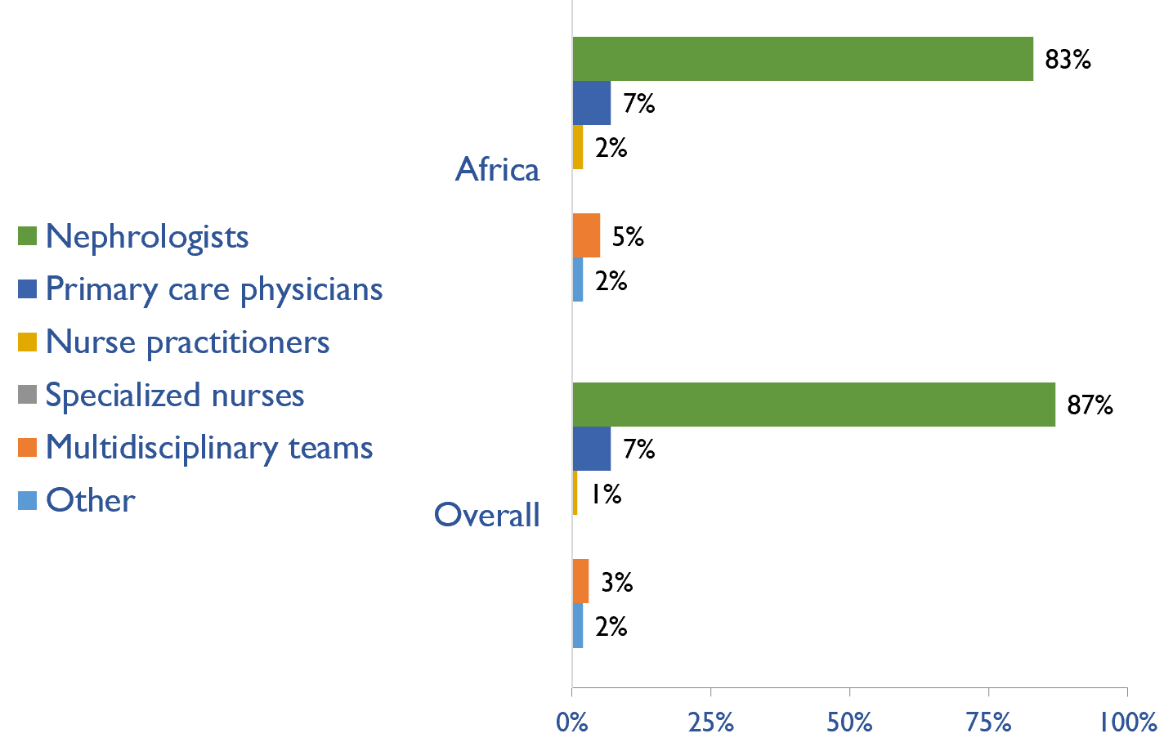
Providers primarily responsible for kidney failure care
Country | Nephrologists | Primary care physicians | Nurse practitioners | Specialized nurses | Multidisciplinary teams | Other
Angola | X
Benin | X
Botswana | X
Burkina Faso | X
Burundi | X
Cameroon | X
Cape Verde | X
C African Republic | X
Chad | X
Congo, Dem. Rep. | X
Congo, Rep. | X
Cote d'Ivoire | X
Egypt, Arab Rep. | X
Ethiopia | X
Gabon | X
Gambia, The | X
Ghana | X
Guinea | X
Kenya | X
Lesotho | X
Madagascar | X
Malawi |  |  |  |  | X
Mali | X
Mauritania | X
Mauritius | X
Morocco | X
Mozambique |  |  | X
Namibia |  | X
Niger | X
Nigeria | X
Senegal | X
Somalia | X
South Africa | X
Sudan | X
Swaziland |  |  |  |  | X
Tanzania |  | X
Togo | X
Tunisia | X
Uganda | X
Zambia |  | X
Zimbabwe |  |  |  |  |  | X

Slide 33
Shortage of kidney failure care providers
Country | Nephrologists | Pediatric nephrologists | Transplant surgeons | Surgeons (HD access) | Surgeons (PD access) | Dietitians | Laboratory technicians | Radiologists (ultrasound) | Vascular access coordinators
Angola
Benin
Botswana
Burkina Faso
Burundi
Cameroon
Cape Verde
C African Republic
Chad
Congo, Dem. Rep.
Congo, Rep.
Cote d'Ivoire
Egypt, Arab Rep.
Ethiopia
Gabon
Gambia, The
Ghana
Guinea
Kenya
Lesotho
Madagascar
Malawi
Mali
Mauritania
Mauritius
Morocco
Mozambique
Namibia
Niger
Nigeria
Senegal
Somalia
South Africa
Sudan
Swaziland
Tanzania
Togo
Tunisia
Uganda
Zambia
Zimbabwe
No shortage
Shortage

Slide 34
Shortage of kidney failure care providers
Country | Counsellors/ psychologists | Transplant coordinators | Dialysis nurses | Renal nurses | Dialysis technicians | Social workers | Palliative care physicians | Kidney supportive care nurses | No shortage
Angola
Benin
Botswana
Burkina Faso
Burundi
Cameroon
Cape Verde
C African Republic
Chad
Congo, Dem. Rep.
Congo, Rep.
Cote d'Ivoire
Egypt, Arab Rep.
Ethiopia
Gabon
Gambia, The
Ghana
Guinea
Kenya
Lesotho
Madagascar
Malawi
Mali
Mauritania
Mauritius
Morocco
Mozambique
Namibia
Niger
Nigeria
Senegal
Somalia
South Africa
Sudan
Swaziland
Tanzania
Togo
Tunisia
Uganda
Zambia
Zimbabwe
No shortage
Shortage

Slide 35
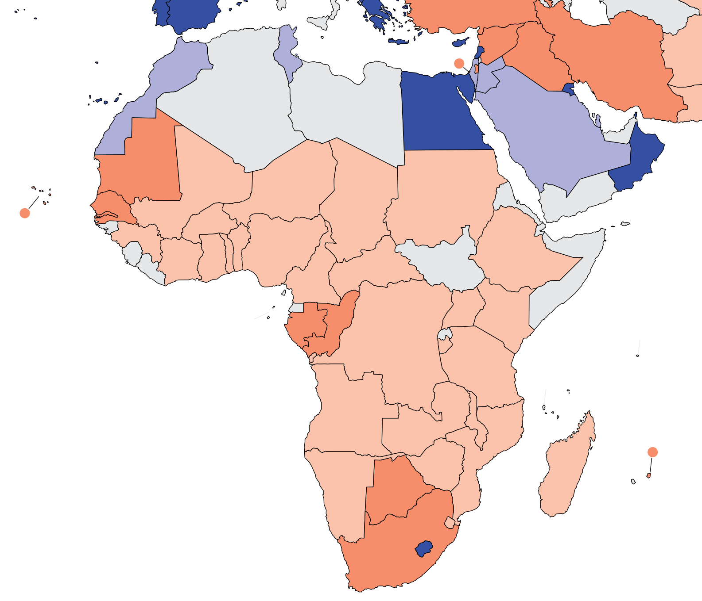
Prevalence of nephrologists and trainees
Country | Nephrologists PMP | Nephrology trainees PMP
Angola | 1.52 | 0.49
Benin | 1.09 | 0.00
Botswana | 2.10 | 1.26
Burkina Faso | 1.41 | 1.23
Burundi | 0.24 | 0.24
Cameroon | 0.51 | 0.17
Cape Verde | 3.35 | 0.00
C African Republic | 0.18 | 0.00
Chad | 0.17 | 0.00
Congo, Dem. Rep. | 0.30 | 0.06
Congo, Rep. | 1.80 | 0.72
Cote d'Ivoire | 1.22 | 0.28
Egypt, Arab Rep. | 32.88 | 3.71
Ethiopia | 0.25 | 0.08
Gabon | 6.84 | 6.41
Gambia, The | 2.07 | 0.00
Ghana | 0.36 | 0.12
Guinea | 1.13 | 0.60
Kenya | 0.91 | 0.09
Lesotho | 93.44 | 6.84
Madagascar | 0.14 | 0.18
Malawi | 0.05 | 0.00
Mali | 1.78 | 0.19
Mauritania | 2.64 | 0.72
Mauritius | 7.64 | 2.29
Morocco | 15.24 | 2.72
Mozambique | 0.09 | 0.03
Namibia | 1.10 | 0.00
Niger | 0.33 | 0.00
Nigeria | 1.55 | 0.22
Senegal | 2.34 | 3.07
Somalia | - | -
South Africa | 2.61 | 0.17
Sudan | 0.98 | 0.23
Swaziland | 1.78 | 0.00
Tanzania | 0.49 | 0.13
Togo | 0.35 | 1.18
Tunisia | 18.49 | 5.46
Uganda | 0.30 | 0.00
Zambia | 0.31 | 0.00
Zimbabwe | 0.40 | 0.07
Nephrologists
‘ – ’ : data not reported/unavailable

Slide 36
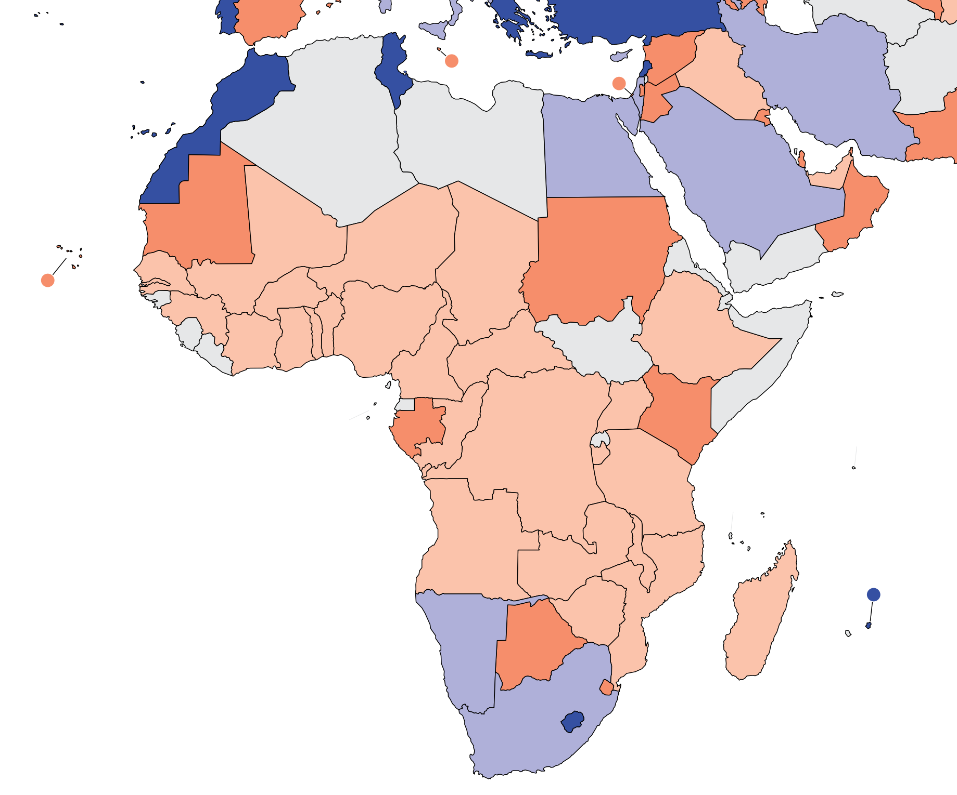
Capacity for chronic dialysis (HD)
Country | Chronic HD Centers PMP
Angola | 0.37
Benin | 0.29
Botswana | 2.10
Burkina Faso | 0.27
Burundi | 0.39
Cape Verde | 0.20
Cameroon | 3.35
C African Republic | 0.18
Chad | 0.11
Congo, Dem. Rep. | 0.18
Congo, Rep. | 1.26
Cote d'Ivoire | 0.31
Egypt, Arab Rep. | 5.53
Ethiopia | 0.18
Gabon | 3.85
Gambia, The | 0.83
Ghana | 0.94
Guinea | 0.38
Kenya | 3.79
Lesotho | 36.46
Madagascar | 0.35
Malawi | 0.19
Mali | 0.63
Mauritania | 3.84
Mauritius | 11.47
Morocco | 11.43
Mozambique | 0.09
Namibia | 5.13
Niger | 0.16
Nigeria | 0.80
Senegal | 1.45
Somalia | -
South Africa | 5.22
Sudan | 1.90
Swaziland | 3.57
Tanzania | 0.70
Togo | 1.06
Tunisia | 15.89
Uganda | 0.26
Zambia | 0.51
Zimbabwe | 1.32
Chronic HD centers
Chronic HD services are available in all countries of the region
The Africa average of HD treatment centers is 3.17 pmp
‘ – ’ : data not reported/unavailable

Slide 37
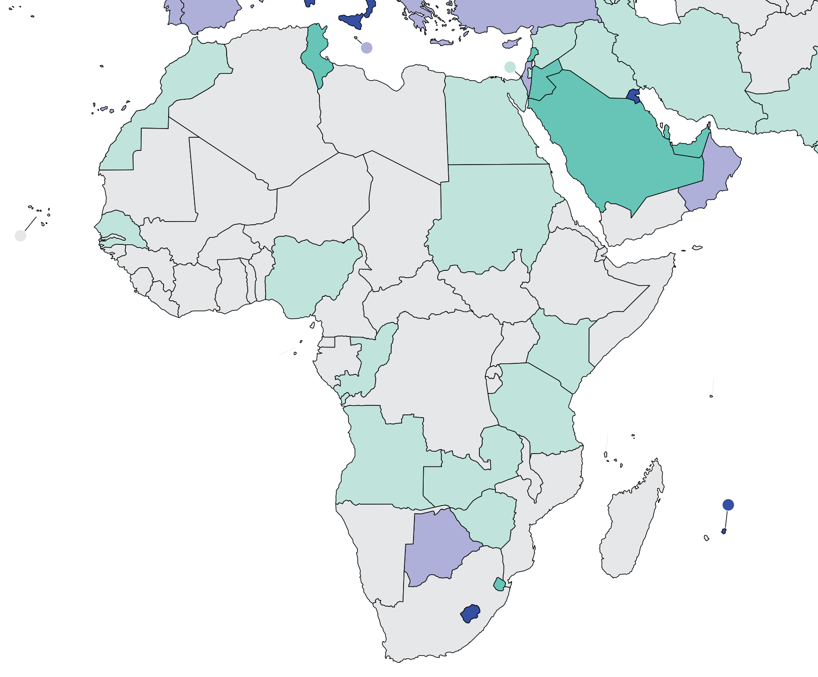
Capacity for chronic dialysis (PD)
Country | Chronic PD Centers PMP
Angola | 0.03
Benin | -
Botswana | 2.10
Burkina Faso | -
Burundi | -
Cameroon | -
Cape Verde | -
C African Republic | -
Chad | -
Congo, Dem. Rep. | 0.03
Congo, Rep. | 0.18
Cote d'Ivoire | -
Egypt, Arab Rep. | 0.03
Ethiopia | -
Gabon | -
Gambia, The | -
Ghana | -
Guinea | -
Kenya | 0.05
Lesotho | 6.84
Madagascar | -
Malawi | -
Mali | -
Mauritania | -
Mauritius | 3.82
Morocco | 0.22
Mozambique | -
Namibia | -
Niger | -
Nigeria | 0.02
Senegal | 0.28
Somalia | -
South Africa | -
Sudan | 0.06
Swaziland | 0.89
Tanzania | 0.08
Togo | -
Tunisia | 0.76
Uganda | -
Zambia | 0.10
Zimbabwe | 0.13
Chronic PD centers
Chronic PD services are available in 19 (48%) countries of the region
The Africa average of PD treatment centers is 0.92 pmp
‘ – ’ : data not reported/unavailable

Slide 38
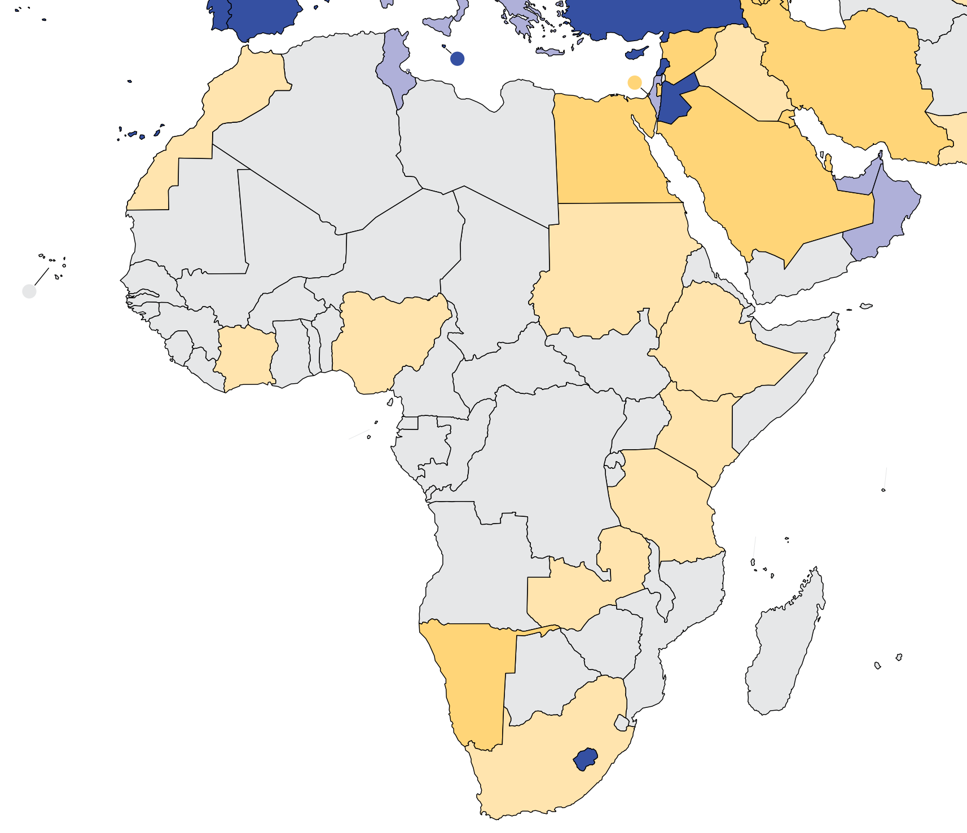
Capacity for Kidney Transplantation
Country | Kidney Transplantation Availability | Transplant centers PMP
Angola
Benin
Botswana
Burkina Faso
Burundi
Cameroon
Cape Verde
C African Republic
Chad
Congo, Dem. Rep.
Congo, Rep.
Cote d'Ivoire | X | 0.03
Egypt, Arab Rep. | X | 0.32
Ethiopia | X | 0.01
Gabon
Gambia, The
Ghana
Guinea
Kenya | X | 0.14
Lesotho | X | 1.82
Madagascar
Malawi
Mali
Mauritania
Mauritius
Morocco | X | 0.19
Mozambique
Namibia | X | 0.37
Niger
Nigeria | X | 0.07
Senegal
Somalia
South Africa | X | 0.12
Sudan | X | 0.15
Swaziland
Tanzania | X | 0.03
Togo
Tunisia | X | 0.50
Uganda
Zambia | X | 0.05
Zimbabwe
Kidney transplantation centers
Kidney transplantation services are available in 13 (33%) countries of the region
The Africa average of Kidney transplantation centers is 0.29 pmp
‘ – ’ : data not reported/unavailable
X : Yes

Slide 39
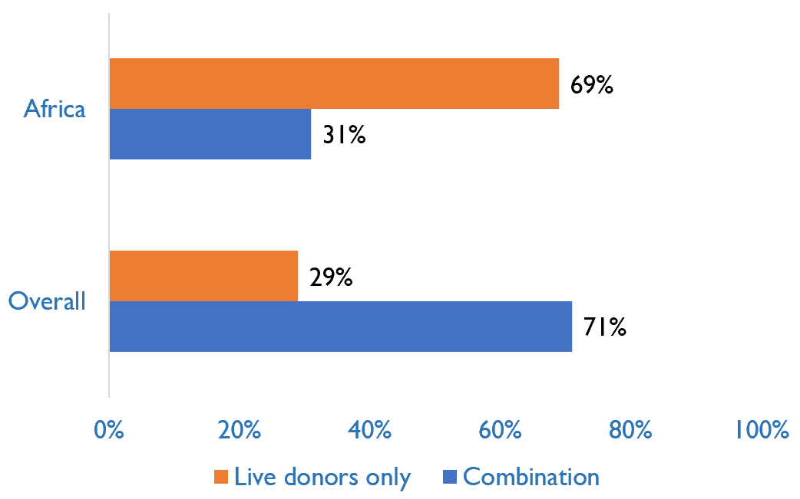
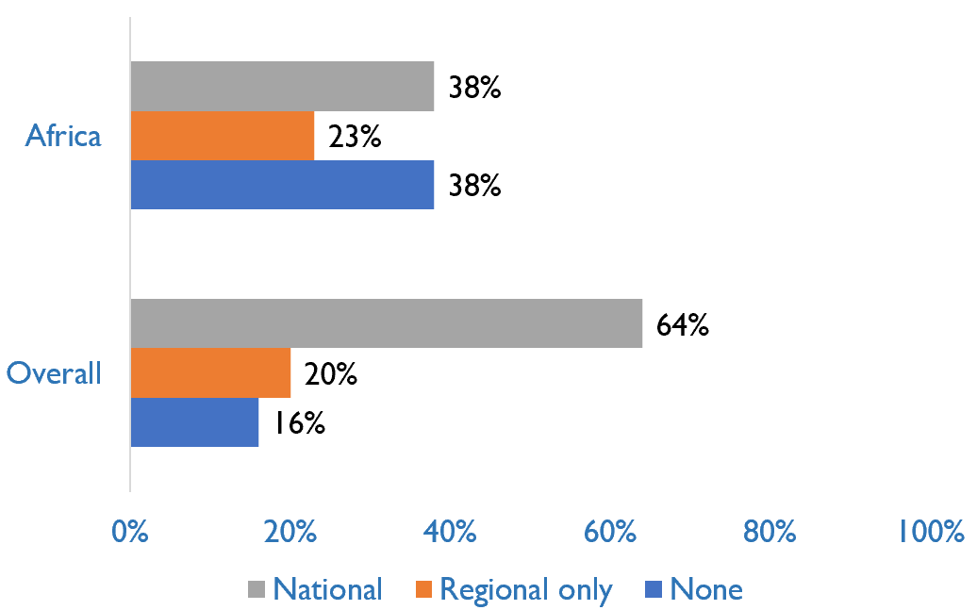
Capacity for Kidney Transplantation (cont’d)
Country | Donor type |  | Transplant waitlist
 | Live donors only | Combination | National | Regional only | None
Angola
Benin
Botswana
Burkina Faso
Burundi
Cameroon
Cape Verde
C African Republic
Chad
Congo, Dem. Rep.
Congo, Rep.
Cote d'Ivoire | X |  |  |  | X
Egypt, Arab Rep. | X |  |  | X
Ethiopia | X |  | X
Gabon
Gambia, The
Ghana | X |  |  |  | X
Guinea
Kenya | X |  |  | X
Lesotho |  | X | X
Madagascar
Malawi
Mali
Mauritania
Mauritius
Morocco |  | X | X
Mozambique
Namibia | X |  |  |  | X
Niger
Nigeria | X |  |  |  | X
Senegal
Somalia
South Africa |  | X |  | X
Sudan | X |  |  |  | X
Swaziland
Tanzania | X |  |  |  | X
Togo
Tunisia |  | X | X
Uganda
Zambia | X |  | X
Zimbabwe
Transplant donor type
Transplant waitlist
X : Yes

Slide 40
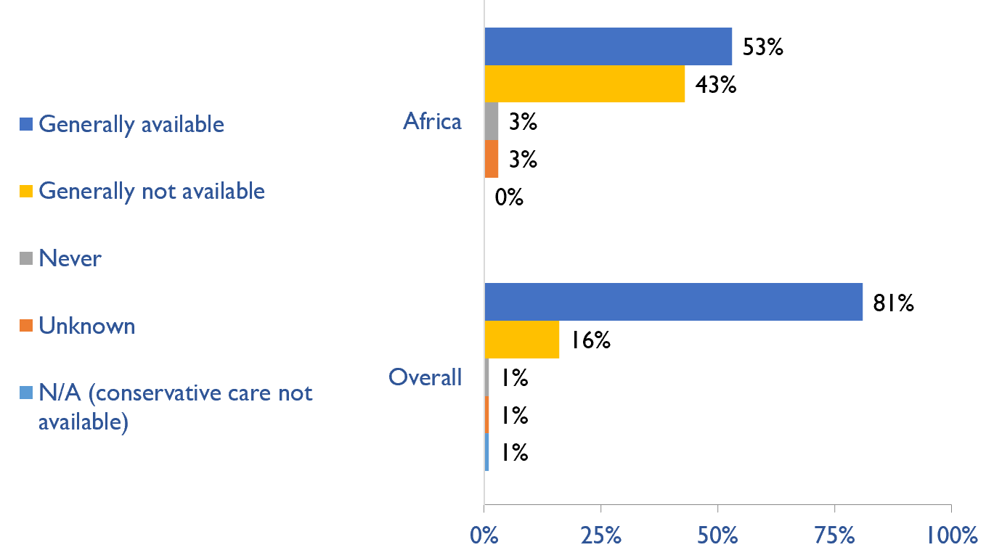
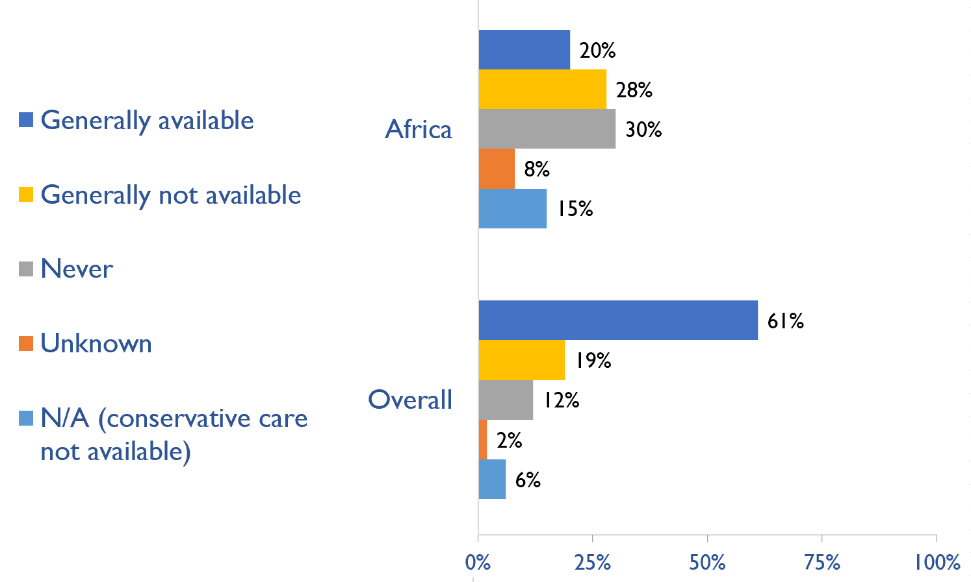
Availability of services within dialysis care
HD frequency
Country | HD frequency a center-based service that involves treatment 3x week/3-4x hours |  |  |  |  | PD frequency ability to do adequate exchanges 3-4x day (or equivalent cycles on automated PD)
 | Generally available | Generally not available | Never | Unknown | N/A (dialysis not provided) | Generally available | Generally not available | Never | Unknown | N/A (dialysis not provided)
Angola | X |  |  |  |  |  | X
Benin | X |  |  |  |  |  |  | X
Botswana | X |  |  |  |  |  | X
Burkina Faso |  | X |  |  |  |  |  |  |  | X
Burundi |  | X |  |  |  |  |  |  |  | X
Cameroon |  | X |  |  |  |  |  | X
Cape Verde | X |  |  |  |  |  |  | X
C African Republic |  |  |  | X |  |  |  |  | X
Chad |  | X |  |  |  |  |  |  |  | X
Congo, Dem. Rep. |  | X |  |  |  | X
Congo, Rep. |  | X |  |  |  |  | X
Cote d'Ivoire |  | X |  |  |  |  |  | X
Egypt, Arab Rep. | X |  |  |  |  |  | X
Ethiopia | X |  |  |  |  |  |  | X
Gabon | X |  |  |  |  |  |  | X
Gambia, The | X |  |  |  |  |  |  | X
Ghana |  | X |  |  |  |  |  | X
Guinea | X |  |  |  |  |  |  | X
Kenya | X |  |  |  |  | X
Lesotho | X |  |  |  |  | X
Madagascar | X |  |  |  |  |  |  |  | X
Malawi |  | X |  |  |  |  | X
Mali |  |  | X |  |  |  |  |  |  | X
Mauritania | X |  |  |  |  |  |  | X
Mauritius | X |  |  |  |  | X
Morocco | X |  |  |  |  | X
Mozambique |  | X |  |  |  |  |  | X
Namibia | X |  |  |  |  |  | X
Niger | X |  |  |  |  |  |  |  | X
Nigeria |  | X |  |  |  |  | X
Senegal |  | X |  |  |  |  | X
Somalia
South Africa | X |  |  |  |  | X
Sudan |  | X |  |  |  |  | X
Swaziland | X |  |  |  |  |  | X
Tanzania |  | X |  |  |  |  |  |  |  | X
Togo |  | X |  |  |  |  |  |  |  | X
Tunisia | X |  |  |  |  | X
Uganda |  | X |  |  |  |  |  | X
Zambia | X |  |  |  |  | X
Zimbabwe |  | X |  |  |  |  | X
PD frequency
X : Yes

Slide 41
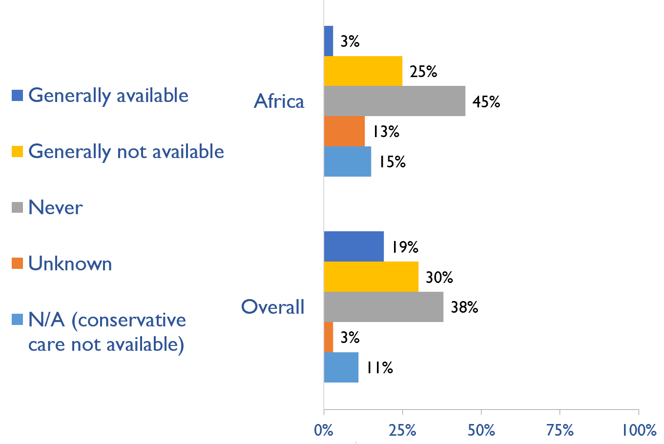
Availability of Home hemodialysis
Country | Availability of Home hemodialysis
 | Generally available | Generally not available | Never | Unknown | N/A (dialysis not provided)
Angola |  |  |  |  | X
Benin |  |  | X
Botswana |  | X
Burkina Faso |  |  |  | X
Burundi |  |  |  |  | X
Cameroon |  |  | X
Cape Verde |  |  | X
C African Republic |  |  |  | X
Chad |  |  |  |  | X
Congo, Dem. Rep. |  |  | X
Congo, Rep. |  |  | X
Cote d'Ivoire |  |  | X
Egypt, Arab Rep. |  | X
Ethiopia |  |  | X
Gabon |  |  | X
Gambia, The |  |  | X
Ghana |  |  |  |  | X
Guinea |  |  | X
Kenya |  | X
Lesotho | X
Madagascar |  |  |  | X
Malawi |  |  | X
Mali |  |  |  |  | X
Mauritania |  |  | X
Mauritius |  |  | X
Morocco |  |  | X
Mozambique |  |  | X
Namibia |  |  | X
Niger |  |  |  | X
Nigeria |  | X
Senegal |  | X
Somalia
South Africa |  | X
Sudan |  |  |  | X
Swaziland |  |  | X
Tanzania |  |  |  |  | X
Togo |  | X
Tunisia |  | X
Uganda |  | X
Zambia |  |  | X
Zimbabwe |  | X
X : Yes

Slide 42
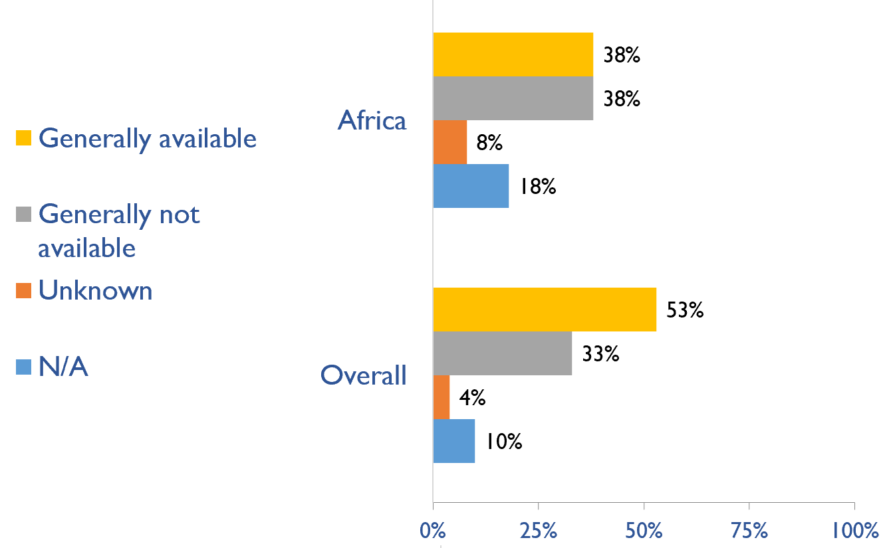
Capacity for conservative kidney management (CKM)
Country | Established conservative care that is chosen or medically advised
 | Generally available | Generally not available | Unknown | N/A (conservative care not available)
Angola |  | X
Benin | X
Botswana | X
Burkina Faso | X
Burundi |  | X
Cameroon |  | X
Cape Verde | X
C African Republic |  |  | X
Chad |  |  | X
Congo, Dem. Rep. |  | X
Congo, Rep. |  | X
Cote d'Ivoire |  | X
Egypt, Arab Rep. | X
Ethiopia | X
Gabon |  |  |  | X
Gambia, The |  |  |  | X
Ghana |  |  |  | X
Guinea |  |  |  | X
Kenya |  | X
Lesotho | X
Madagascar | X
Malawi |  | X
Mali |  | X
Mauritania | X
Mauritius | X
Morocco |  | X
Mozambique |  |  |  | X
Namibia | X
Niger | X
Nigeria |  | X
Senegal |  | X
Somalia
South Africa |  | X
Sudan |  |  | X
Swaziland |  |  |  | X
Tanzania |  |  |  | X
Togo | X
Tunisia |  | X
Uganda | X
Zambia | X
Zimbabwe |  | X
X : Yes

Slide 43
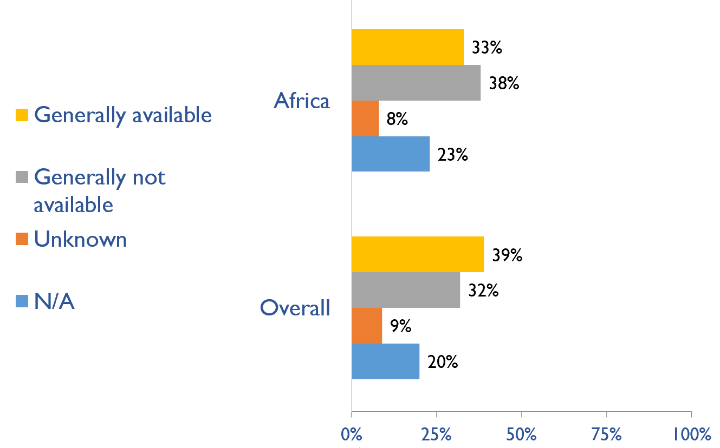
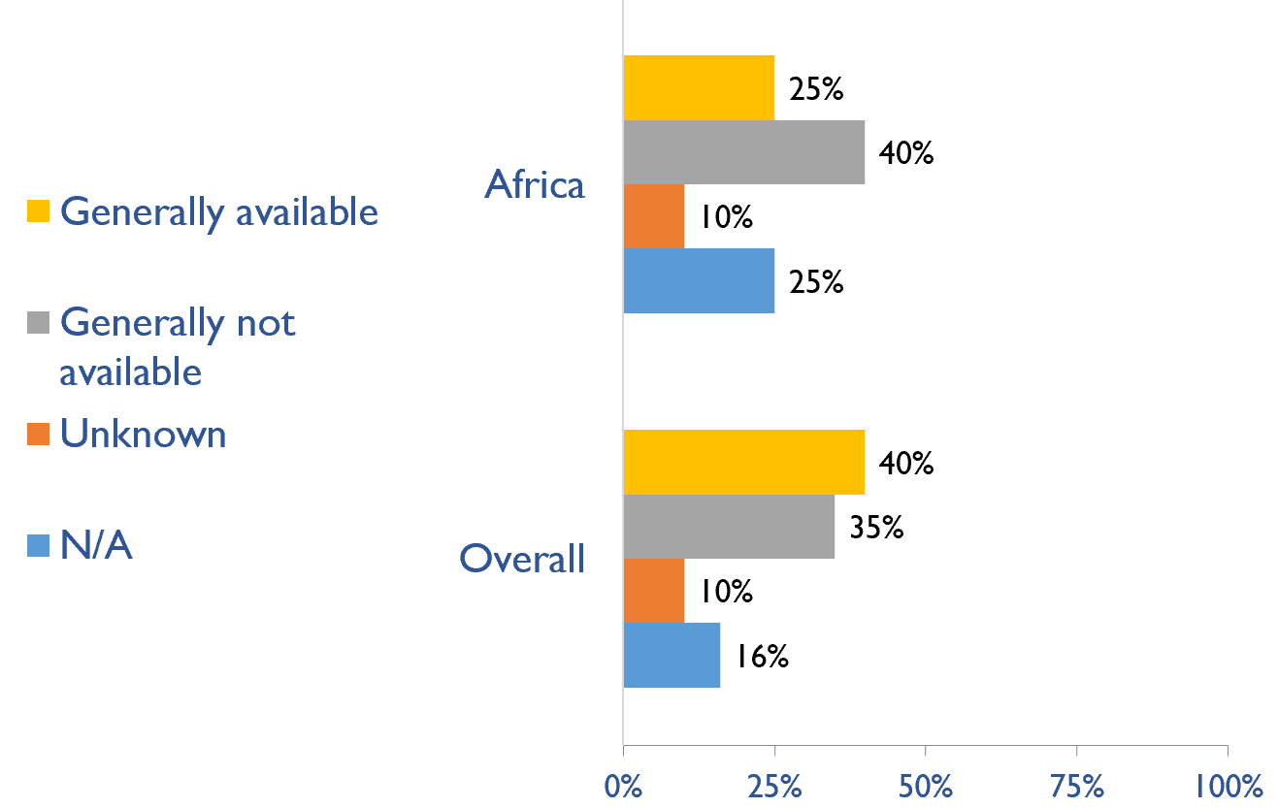
Capacity for conservative kidney management (CKM)
Where resource constraints to prevent or limit access to KRT
Country | where resource constraints to prevent or limit access to KRT |  |  |  | where there are no resource constraints to prevent or limit access to KRT
 | Generally available | Generally not available | Unknown | N/A (conservative care not available) | Generally available | Generally not available | Unknown | N/A (conservative care not available)
Angola |  | X |  |  |  | X
Benin |  | X |  |  |  | X
Botswana | X |  |  |  | X
Burkina Faso | X |  |  |  |  | X
Burundi | X |  |  |  |  | X
Cameroon |  |  | X |  |  |  | X
Cape Verde | X |  |  |  | X
C African Republic |  |  | X |  |  |  | X
Chad |  | X |  |  |  |  | X
Congo, Dem. Rep. |  | X |  |  |  | X
Congo, Rep. |  | X |  |  |  | X
Cote d'Ivoire |  | X |  |  |  | X
Egypt, Arab Rep. |  | X |  |  |  | X
Ethiopia | X |  |  |  |  |  |  | X
Gabon |  |  |  | X |  |  |  | X
Gambia, The |  |  |  | X |  |  |  | X
Ghana |  |  |  | X |  |  |  | X
Guinea |  |  |  | X |  |  |  | X
Kenya |  | X |  |  |  | X
Lesotho |  |  |  | X | X
Madagascar | X |  |  |  | X
Malawi |  | X |  |  |  |  |  | X
Mali | X |  |  |  | X
Mauritania |  | X |  |  |  | X
Mauritius |  |  |  | X |  |  |  | X
Morocco | X |  |  |  | X
Mozambique |  |  |  | X |  |  |  | X
Namibia | X |  |  |  | X
Niger |  | X |  |  |  | X
Nigeria |  | X |  |  |  | X
Senegal |  | X |  |  |  | X
Somalia
South Africa | X |  |  |  |  | X
Sudan |  |  | X |  |  |  | X
Swaziland |  |  |  | X |  |  |  | X
Tanzania |  |  |  | X |  |  |  | X
Togo | X |  |  |  | X
Tunisia |  | X |  |  |  | X
Uganda | X |  |  |  | X
Zambia | X |  |  |  | X
Zimbabwe |  | X |  |  |  | X
Where there are no resource constraints to prevent or limit access to KRT
X : Yes

Slide 44
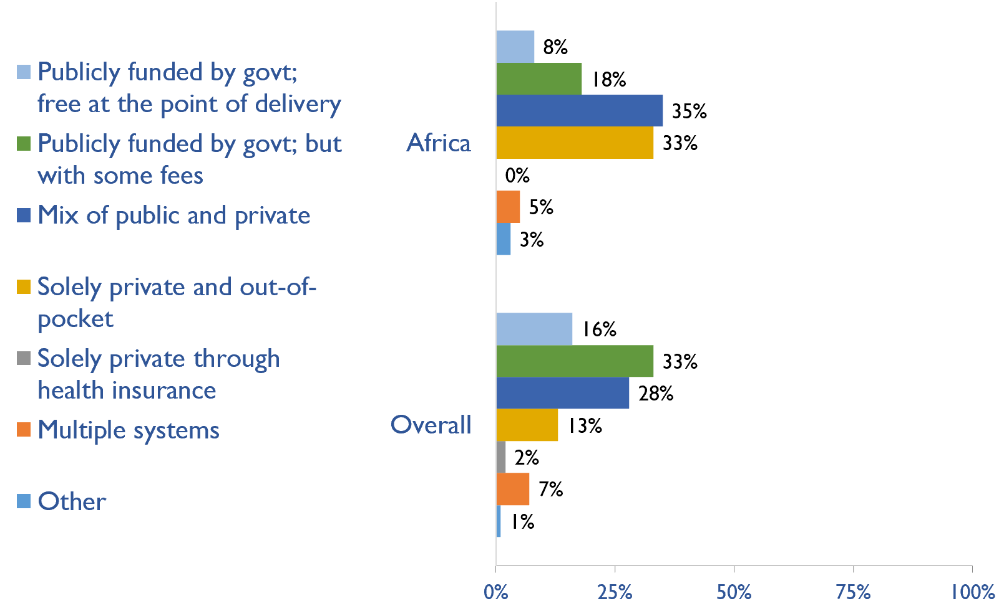
Funding for medications in CKD patients not on dialysis
Country | Publicly funded by govt; free at the point of delivery | Publicly funded by govt but with some fees | Mix of public and private funding systems | Solely private and out-of-pocket | Solely private through health insurance providers | Multiple systems | Other
Angola |  |  |  | X
Benin |  |  | X
Botswana |  | X
Burkina Faso |  |  |  | X
Burundi |  |  |  |  |  | X
Cameroon |  |  |  | X
Cape Verde |  |  | X
Central African Rep. | X
Chad |  |  |  | X
Congo, Dem. Rep. |  |  |  | X
Congo, Rep. |  |  | X
Cote d'Ivoire |  |  |  | X
Egypt, Arab Rep. |  |  | X
Ethiopia |  | X
Gabon | X
Gambia, The | X
Ghana |  |  | X
Guinea |  |  |  | X
Kenya |  |  | X
Lesotho |  |  | X
Madagascar |  |  |  | X
Malawi |  |  | X
Mali |  |  |  |  |  |  | X
Mauritania |  |  |  | X
Mauritius |  |  | X
Morocco |  |  | X
Mozambique |  | X
Namibia |  |  | X
Niger |  |  |  | X
Nigeria |  |  |  | X
Senegal |  |  |  |  |  | X
Somalia
South Africa |  |  | X
Sudan |  |  |  | X
Swaziland |  | X
Tanzania |  |  | X
Togo |  |  |  | X
Tunisia |  | X
Uganda |  |  | X
Zambia |  | X
Zimbabwe |  | X
X : Yes

Slide 45
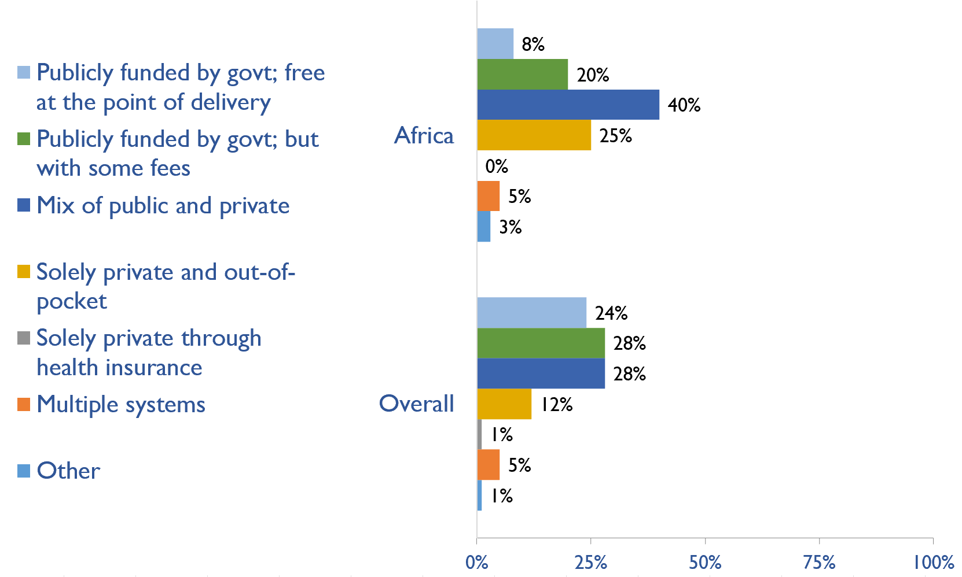
Funding for medications in all dialysis patients
Country | Publicly funded by govt; free at the point of delivery | Publicly funded by govt but with some fees | Mix of public and private funding systems | Solely private and out-of-pocket | Solely private through health insurance providers | Multiple systems | Other
Angola |  |  |  | X
Benin |  |  | X
Botswana |  | X
Burkina Faso |  |  | X
Burundi |  |  |  |  |  | X
Cameroon |  |  |  | X
Cape Verde |  |  | X
Central African Rep. | X
Chad |  |  |  | X
Congo, Dem. Rep. |  |  |  | X
Congo, Rep. |  |  | X
Cote d'Ivoire |  | X
Egypt, Arab Rep. |  |  | X
Ethiopia |  |  | X
Gabon | X
Gambia, The | X
Ghana |  |  | X
Guinea |  |  |  | X
Kenya |  |  | X
Lesotho |  |  | X
Madagascar |  |  |  | X
Malawi |  |  | X
Mali |  |  |  |  |  |  | X
Mauritania |  | X
Mauritius |  |  | X
Morocco |  |  | X
Mozambique |  | X
Namibia |  |  | X
Niger |  |  |  | X
Nigeria |  |  |  | X
Senegal |  |  |  |  |  | X
Somalia
South Africa |  |  | X
Sudan |  |  |  | X
Swaziland |  | X
Tanzania |  |  | X
Togo |  |  |  | X
Tunisia |  | X
Uganda |  |  | X
Zambia |  | X
Zimbabwe |  | X
X : Yes

Slide 46
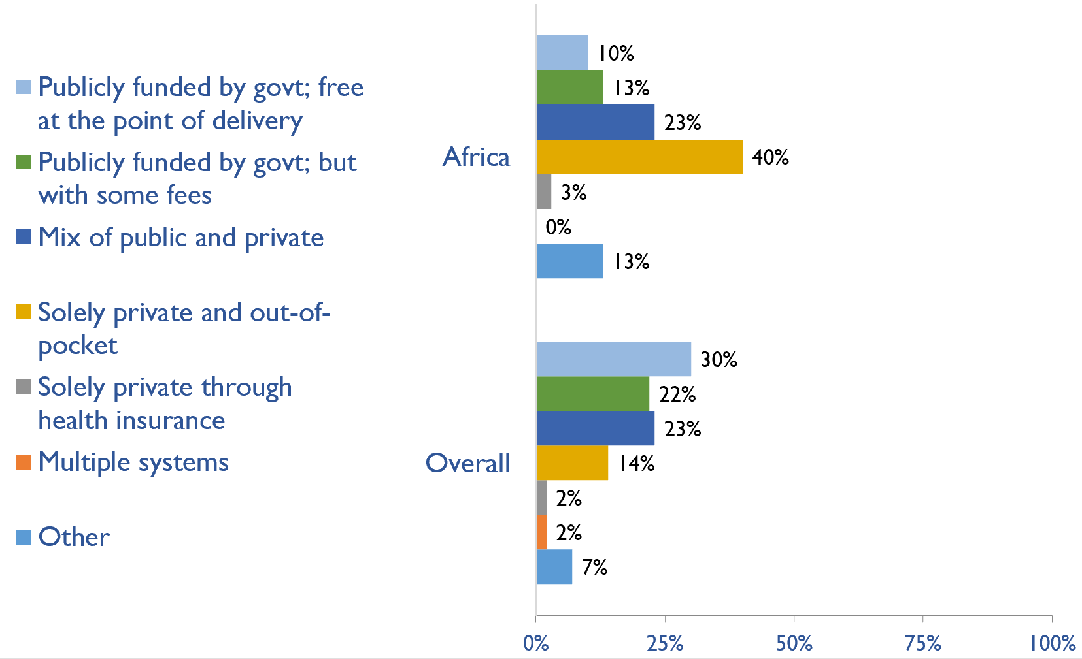
Funding for medications in all transplant patients
Country | Publicly funded by govt; free at the point of delivery | Publicly funded by govt but with some fees | Mix of public and private funding systems | Solely private and out-of-pocket | Solely private through health insurance providers | Multiple systems | Other
Angola |  |  |  | X
Benin |  |  |  |  |  |  | X
Botswana |  | X
Burkina Faso |  |  |  | X
Burundi |  |  |  |  |  |  | X
Cameroon |  |  |  | X
Cape Verde |  |  | X
Central African Rep. | X
Chad |  |  |  | X
Congo, Dem. Rep. |  |  |  | X
Congo, Rep. |  |  | X
Cote d'Ivoire |  |  |  | X
Egypt, Arab Rep. |  |  | X
Ethiopia |  | X
Gabon |  |  |  |  |  |  | X
Gambia, The |  |  |  |  | X
Ghana |  |  |  | X
Guinea |  |  |  |  |  |  | X
Kenya |  |  | X
Lesotho |  |  | X
Madagascar |  |  |  | X
Malawi |  |  |  | X
Mali |  |  |  |  |  |  | X
Mauritania |  |  |  | X
Mauritius | X
Morocco |  |  | X
Mozambique |  | X
Namibia |  |  | X
Niger |  |  |  | X
Nigeria |  |  |  | X
Senegal |  |  |  | X
Somalia
South Africa |  |  | X
Sudan | X
Swaziland |  | X
Tanzania |  |  | X
Togo |  |  |  | X
Tunisia | X
Uganda |  |  |  | X
Zambia |  | X
Zimbabwe |  |  |  | X
X : Yes

Slide 47
Availability of official registry
Country | CKD | Dialysis | Transplant | AKI | Conservative care
Angola |  | X
Benin
Botswana | X | X | X | X | X
Burkina Faso
Burundi
Cameroon
Cape Verde
C African Republic
Chad
Congo, Dem. Rep.
Congo, Rep.
Cote d'Ivoire |  | X
Egypt, Arab Rep. |  | X | X
Ethiopia
Gabon
Gambia, The
Ghana |  | X
Guinea | X |  |  | X | X
Kenya | X | X | X
Lesotho
Madagascar
Malawi |  | X |  | X
Mali
Mauritania
Mauritius |  | X | X
Morocco |  | X
Mozambique
Namibia
Niger |  | X |  | X
Nigeria
Senegal
Somalia
South Africa |  | X | X
Sudan
Swaziland
Tanzania
Togo
Tunisia
Uganda
Zambia |  | X
Zimbabwe
X : Yes

Slide 48
Summary of Findings
In summary, the 2023 ISN-GKHA highlights several important findings for Africa.
There remains limited availability and quality of delivered KRT.
In-centre HD was available in all countries (100%), PD in 19 (48%) of countries, and KT in 13 (33%) of countries.
While all countries have HD, the capacity to provide adequate HD frequency (3 – 4 hours/ session, was available in 21 (53%) countries in Africa while the capacity to provide adequate PD exchanges i.e., 3 – 4 exchanges/ day was available in 8 (20%) countries.
Only one country (Lesotho) has home HD available in the continent.
Conservative kidney management
Established CKM through shared-decision making is more readily available in 38% of countries than choice restricted CKM (where resource constraints prevent or limit access) in 33% of countries, and choice restricted CKM (where no resource constraints prevent or limit access) in 25% of countries.
Public government funding for kidney care remains low in Africa.
Few countries in Africa cover the cost of kidney care using public government funds.
Only 10 countries (24%) use public government funds (and free at point of delivery) to cover the cost of acute dialysis (whether HD or PD) and 34% of countries cover the cost of chronic HD using this method while 15% cover PD cost using this method.
More countries (22%) cover the cost of KT medications through private and out-of-pocket methods than countries that provide public funding (12%) for coverage.

Slide 49
Summary of Findings (cont’d)
Few registries across all levels of kidney disease
Few countries have a registry for any level of kidney disease. Overall, 12 (31%) of countries had a dialysis registry (Angola, Botswana, Cote d’Ivoire, Egypt, Ghana, Kenya, Malawi, Mauritius, Morocco, Niger, South Africa, and Zambia) while 5 (13%) of countries had a KT registry (Botswana, Egypt, Kenya, Mauritius, and South Africa).
Critical workforce shortages across African countries.
Overall, prevalence of nephrologists was low at 1.12 pmp with the lowest recorded in Madagascar (0.14 pmp). Similarly, prevalence of nephrology trainees was also low (0.18 pmp) and was highest in Lesotho (6.8 pmp).
More than three-quarters of countries reported shortages of workforce including nephrologists, paediatric nephrologists, transplant surgeons, interventional surgeons for AVF/AVG and for PD catheter access, vascular access coordinators, dietitians, and transplant coordinators.
Lack of advocacy and recognition of kidney disease as a priority in Africa.
Despite a high burden of kidney disease in Africa, kidney diseases are not formally recognized by governments as a health priority in the continent.
Less than half of countries (49%) recognize CKD as a health priority while few advocacy groups exist for all forms of kidney disease including AKI, CKD, kidney failure, and KRT.

Slide 50
Implications
There are important implications to consider. Based on these survey findings, key recommendations to drive future activities for optimizing kidney care globally are proposed:
Increase health care financing for kidney failure prevention and management.
While resource limitations are an obvious barrier, focusing on preventing kidney failure through appropriate hypertension and diabetes management may be more cost-effective overall. Government funding to cover medication costs may allow more patients to treat earlier stage CKD, thereby preventing the need for more costly kidney failure treatment and the obvious burden this has on patients’ wellbeing.
Address workforce shortages through multidisciplinary teams and telemedicine
Shortages of nephrologists, surgeons, dialysis nurses, and other key allied health professionals were noted across most countries. Similarly, simply producing more nephrologists may not be feasible or appropriate, and sharing the workload across multiple providers will not only promote the use of multidisciplinary teams but further, allow for more and better care delivery across more patients. Telemedicine may help particularly in addressing gaps in care among rural patients and enhancing capacity through training programs such as ISN Fellowship, visiting ambassador programs, etc.

Slide 51
Implications (cont’d)
Incorporate the collection and reporting of quality indicators in kidney failure care.
Measuring and reporting on key quality indicators is an important driver in healthcare improvement. Ensuring facilities are supported with information systems that allow for the systematic measurement and reporting of indicators is a first key step to increasing the rate of monitoring among countries. Further, understanding if or how the collection and reporting of indicators are being used to improve care is needed.
Expand health information systems to prevent and manage kidney failure.
Similarly, good quality HIS are vital for kidney disease management within a country. A lack of data on disease prevalence, incidence, resource use, and quality of care limits government and provider ability to monitor and evaluate the care provided as well as predicts appropriate resource allocation so that sufficient facilities, medicines, and healthcare professionals are trained and available.
Promote kidney failure prevention and treatment by implementing policies, strategies, and advocacy, and mitigating barriers.
Lastly, policies and strategies are important for consistent approaches within a country for optimal care delivery, as well as for accountability, leadership, and knowledge exchange. Advocacy may help promote the increase of government prioritization and further, public awareness of how to prevent and manage kidney disease. Without acknowledging and mitigating barriers, it would be a challenge to achieve of successes out of these recommendations. Competing priorities and needs (for example, clean water supply and basic sanitation, maternal and child health, malnutrition, etc.) represent formidable barriers that can limit implementation of the recommended strategies in the region.

Slide 52







www.theisn.org
Global Operations Center
Americas Operations Center
Avenue des Arts 1-2
1210 Brussels, Belgium
340 North Avenue 3rd Floor Cranford, NJ 07016-2496, United States
+ 32 2 808 04 20
+1 904 345 0866
info@theisn.org
info@theisn.org
Follow us

